Slide 1


Salam
Business Continuity Management Consultancy Services | Technical Proposal
11th January 2024
Deloitte Reference: JO-7281162

Slide 2
Deloitte & Touche Advisory Saudi Ltd.
Prince Turki Bin Abdullah Al-Saud Street, Sulaimania Area
P.O. Box: 213, Riyadh – 11411, Kingdom of Saudi Arabia
Tel:+966 (0)11 2828 500
Fax:+966 (0)11 4761 350
www.deloitte.com
Private & Confidential
Deloitte Ref.: JO-7281162
January 11, 2024
On behalf of Deloitte & Touche Advisory Saudi Limited, hereinafter referred to as “Deloitte” and the members of our service team, we thank you for giving Deloitte the opportunity to submit our proposal for “Business Continuity Management (BCM) Consultancy Services” to your esteemed organization. It is an opportunity to develop our relationship with ‘Salam’ and support you to obtain the desired outcomes. This proposal includes all the pertinent information required to address your needs and contains details of our people, credentials, tools and technology that differentiate Deloitte from the competition. Deloitte is the most qualified firm to meet your objectives, and this is based on the following: Our Approach – We have developed our approach based on our extensive experience in establishing and implementing Business Continuity Management (BCM), Crisis Management and Disaster Recovery programs across the region, combined with our knowledge from delivering several end-to-end BCM programs in the Kingdom based on standards like ISO 22301:2019, ISO 22361:2022 and relevant international best practices. In our proposed approach we have considered and provided activities to ensure that maximum benefit is delivered through the journey of this project. Our Relevant Experience – Our proposed team has delivered various resilience programs within the Middle East. We have significant experience in establishing and implementing operational resilience, developing business continuity and crisis management capabilities and establishing the governance for effective resilience implementations. We have extensive experience in national and international standards (e.g., National Risk Council Resilience Guidelines, NCA ECC, DGA BCM Standard, ISO 22301, ISO 22361 etc.) and have delivered numerous engagements for clients in various different industries. Specifically in the telecom sector we successfully delivered BCM and Risk Management Maturity Assessment for stc Group (Parent and subsidiaries), BCM Implementation for solutions by stc, BCM Implementation for Channels by stc, BCM Program Development for stc Pay, amongst others. Our Engagement Team – Our diverse, multicultural and multilingual team has outstanding BCM experience with over 35 dedicated, BCM trained and certified professionals in the region, supported by 250 risk consultants. Our team received recognition by the Business Continuity Institute (BCI) as the 2016 Continuity & Resilience Provider and the 2014 Business Continuity Provider and GCC Security Symposium & CISO Awards 7th Edition in Riyadh and UAE in the Year 2023. Our proposed team for this project consists of local and regional resources that have prior experience with several other organizations and will bring their experience directly to you. We look forward to extend our working relationship and are excited about the opportunity to serve Salam on this important project. If you have any questions regarding the content of this proposal, please do not hesitate to contact our Cyber Partner, Tariq Ajmal at +971506522859, tajmal@deloitte.com or our Crisis & Resilience Leader for KSA & UAE, Arsalan Yousuf at aryousuf@deloitte.com or +966595615678. Yours sincerely, Khaled Al Sagga Partner Deloitte & Touche Advisory Saudi Limited
Tamer M Abdulwahab
Sr. Contracts Manager
Salam, Riyadh
Kingdom of Saudi Arabia

Slide 3
Table of contents
1
Executive Summary
2
Approach & Methodology
3
Project Timeline
4
Our Team
5
Credentials
6
About Deloitte
7
Assumptions
8
General Business Terms and Conditions

Slide 4
Executive Summary
Our mission in Risk Advisory (RA) in Deloitte is to protect and create value for organizations by taking a risk intelligent approach towards managing financial, regulatory, technology, and business risks.
We also strive to provide global, end-to-end, innovative, and risk-intelligent solutions tailored to priority industries and segments.

Slide 5





Executive Summary
6 Compelling Reasons to Choose Deloitte
We believe that an effective BCM program requires a broad experience, knowledge and skills. Deloitte proposes their full range of capabilities and expertise in the BCM space and in the industry, allowing us to assist and guide Salam in the best possible way.
Our Understanding of Your Needs
Our Team
1
4
Our Expertise
Our Familiarity with Standards
2
5
Our Engagement Approach
Our Reputation as Market Leader
3
6

Slide 6
Executive Summary
Our Understanding of Your Needs
Salam aims to enhance resilience and operational excellence by availing resilience support consultancy and Business Continuity Advisor services.
Salam Overview
Project Goal
Project Execution
Salam (previous ITC), is a leading Saudi-based telecom provider offering next-generation ICT solutions for broadband, connectivity, cloud computing, managed services, security services, satellite services, and internet services for government, businesses, wholesale, and consumer sectors.
The objective is to develop and implement Business Continuity Management System (BCMS) to ensure the following:
organization's resilience to disruptions, protect stakeholder interests, and meet international standards and legal and regulatory requirements
Address organizational goals while addressing applicable regulatory requirements & leading practices aligned with ISO 22301:2019 and other related standards
Provide trainings and awareness for All Salam employees about their roles in the BCMS that leads to gain the knowledge and ability to execute its plans.
Salam project goals have been translated in to two stream of works as follows:
BCM Consultancy Services
Business Continuity Management system establishment, implementation, and performance measures.
Business Continuity Advisory
Support with ongoing business continuity operations and maintenance through secondment of a BCM expert (6 months, extendable)

Slide 7
































Executive Summary
Our Expertise
Our Middle East BCM practice has experienced practitioners and consultants certified in the business continuity field. We have successfully developed and evolved BCMS, implemented end-to-end projects, assessed readiness and maturity, and advised on BCM best practices.

Slide 8










Executive Summary
Our Experience in KSA Telecom Sector
Order to Cash
Record to Report
Procurement
Human Resources
Procurement Focused Contract (Forensic)
Lead to Market Review
Cyber Security Review
IT Governance
Internal Controls Review 2021 (Ongoing)
Risk Assessment & IA Plan Development
Internal Controls Review 2020
Enterprise Risk Management Roll-Out / Implementation
Strategic KRIs & KRI Framework
Cybersecurity Review
Services Development Review
Internal Controls Review 2021
Enterprise Risk Management
Internal Controls Review
TAWAL
stc Parent
Solutions by stc
Channels by stc
stc pay
Center3
CCC
AQALAT
Specialized by stc
STC Kuwait
Intigral
Site Lease & Acquisition IA Review
Operations IA Review
IA Secondments 2022 (Ongoing)
Risk Assessment & IA Plan Development
Internal Controls Review 2021 (Ongoing)
Internal Controls Review 2020
Internal Audit Services 2022
RM & BCM Subsidiaries maturity assessment
Cybersecurity Resilience Program
Internal Controls Review 2022 (Ongoing)
Risk Management Program 2021-2022 (Ongoing).
Internal Controls Review 2021
Compliance Management Maturity Assessment & IA Review.
Technology Strategy & Architecture Audit
5G Readiness Review
Enterprise Architecture Audit (Ongoing)
Enterprise Risk Assessment & Compliance Management
Business Continuity Management
Risk Appetite Development
Risk Assessment & IA Plan
Revenue & Cost of Revenue
Connectivity Services & Telecom Technical
GRC Function Assessment including Cyber Security
Product Development Life Cycle
Alliances and Partnership
Business Continuity Management
Governance, Risk & Compliance Engagements (Ongoing)
Quality, Risk & Compliance Consultancy Program
Risk Assessment & Development of IA Plan
Internal Controls Review
Governance, Risk and Compliance Secondment (ongoing)
BCM & DRP Development & Enhancement
Third Party Assessment (Ongoing)
Setup of Enterprise Risk Framework
Development & Enhancement of Policies
Business Continuity Management Program

Slide 9



Executive Summary
Our Experience in KSA Telecom Sector
Client
solutions by stc
Deloitte was engaged by STC Solutions to implement a holistic BCM Program and integrating it with the existing Enterprise Risk Management framework.
Services Provided
Establishing BCM governance policy and procedures
Performing Threat Risk Assessment and Business Impact Analysis for the entire organization identifying the time-critical services, business processes and their respective recovery requirements
Developed Business Continuity Plans and Recovery Strategies that will support solutions in recovering their time critical services and operations in a timely manner.
Developed Crisis Management and Crisis Communication Plans to assist the Senior Management address any adverse situation
Impact Delivered
Conducted several trainings and tabletop exercises for BCPs and Crisis Management Plan
Based on the BCMS developed and implemented by Deloitte, STC Solutions obtained ISO 22301 Certification in 2020.
Client
channels by stc
Deloitte was engaged by STC Channels to review and update channels‘ existing BCM program.
Services Provided
Review and enhance the overall BCM Program governance and framework
Conduct Business Impact Analysis and Threat Risk Assessment for the organization’s departments and services, identifying critical services and products, associated processes and their recovery requirements
Develop recovery strategies to support recovering critical services and the associated processes within the recovery timeframes, and documented the continuity plans
Developed Crisis Management and Crisis Communication Plans to assist the Senior Management address any adverse situation .
Impact Delivered
Conducted several trainings and tabletop exercises for BCPs and Crisis Management Plan, enabling Channels enhance its preparedness for disruptive incidents.
Client
stc Pay
Deloitte was engaged by stc Pay to establish develop its business continuity and disaster recovery capabilities in line with ISO 22301 and SAMA BCM Framework requirements.
Services Provided
Develop BCM Policy, Governance and manual setting establishing the base for BCMS.
Conduct Business Impact Analysis and Threat Risk Assessment for all in-scope departments and locations
Identify suitable recovery strategies, develop business continuity and disaster recovery plans
Develop incident and crisis management framework, crisis management plan and crisis communication plan.
Impact Delivered
Conducted trainings and tabletop exercises for BCPs and CMP.
Enabled stc Pay to achieve compliance against ISO 22301 and SAMA BCM Framework requirements.

Slide 10
Executive Summary
Our Team
Engagement Leadership
Roles | Responsibilities
Engagement Leadership | Overall responsibility for planning, coordination and delivery of project outputs. Identify and assign appropriate resources to the project.
Engagement Management and Subject Matter Experts | Ensure objectives are met within timing and scope outlined. Manage day-to-day activities. Provide regular status updates to respective management as required.
Subject Matter Expert (SME) | Provide guidance on the challenges and complicated topics.
Core Team | Perform fieldwork under direction of Engagement Manager. Prepare deliverables draft Seconded resource will be available onsite for the no. of working days per month mutually agreed between Deloitte and Salam.
Quality Assurance Partner
Engagement Partner
Engagement Leader
Nader Farid
Partner
Tariq Ajmal
Partner
Maarten Smulders
Director
Engagement Management and Subject Matter Experts
Subject Matter Expert
Engagement Manager
Subject Matter Expert
Arsalan Yousuf
Director
Esam Shana’a
Senior Manager
Syed Waqi Hasan
Senior Manager
Core Team
Varsha Sastry
Senior Consultant
Abdulrahman Almasri
Consultant
Ibrahim Almoudaifer
Business Analyst
Deloitte Resource Pool
Deloitte Resource pool - Deloitte is the largest integrated risk consulting practice in the Middle East with more than 250 professionals. These resources can be further augmented by regional and global professionals and Subject Matter Experts (as needed); however, the SMEs are not expected to be onsite.
Deloitte reserves the right to adjust the engagement team and subject matter experts based on the exact engagement start, planning and the availability of our engagement team members.
10

Slide 11












Executive Summary
Our Methodology
Deloitte utilizes the below approach to implement BCMS in line with ISO 22301:2019 and CST. This encapsulates a phased approach which sets the tone at the top with BCM Governance, analysis of business-critical operations, design the recovery strategies and develop the recovery plans. This is further supported to enhance the Resilience culture of the organization through Training and Exercising and a Performance Improvement System.
Business Continuity Management System
BCM Program Governance
Analysis
Strategies and Plans Design
Training & Exercising
Improvement
Business Understanding
Business Impact Analysis (BIA)
Crisis Management & Communication Plan (CMP)
Internal Audit
Training
BCM Governance Framework and Policies and Procedures
Recovery Strategies
Awareness
Management Review
Business Continuity Plans (BCP)
Exercising
Performance Evaluation
Threat Risk Assessment (TRA)
Current State Assessment
IT Disaster Recovery Plan
Continual Improvement, Maintenance, Awareness and Communication

Slide 12
Executive Summary
Our Reputation as Market Leader – Recognition
Deloitte is recognized as a global leader in capabilities, vision and execution
For several consecutive years, industry analysts have maintained their perspective on Deloitte Consulting practices globally.
As the world's largest management consulting business, Deloitte is distinct in its ability to help clients solve their most complex problems, from strategy to implementation.
We are differentiated by our capability to execute the advice we provide to help clients in the markets where they operate today and where they want to be in the future. Delivering this kind of value requires the skills to integrate a broad range of talent and skills – across human capital, strategy & operations, and technology – aligned to the unique needs of our clients’ industry sectors, businesses, and organizations.
#1
globally in
Consulting based
on revenue by
Gartner¹
A
worldwide leader in Business Consulting Services based on capability and strategy by IDC MarketScape²
#1
globally in Consulting based on revenue and market share by Kennedy³
What the Analysts say about Deloitte
A
global leader
in Business Transformation consulting based on strategy and current offering” by Forrester ⁵
A leader
in Global Risk Management Consulting Services, based on completeness of vision and ability to execute” by Gartner ^{3a}
A
worldwide leader
in Organizational Consulting Services based on capability and strategy” by IDC ⁴
A
global
Leader
in IT Consulting to the Energy & Utilities Industries based on capabilities” by Kennedy ²
A global
leader in Forensics & Dispute Advisory services based on breadth and depth capabilities” by Kennedy ¹

Slide 13


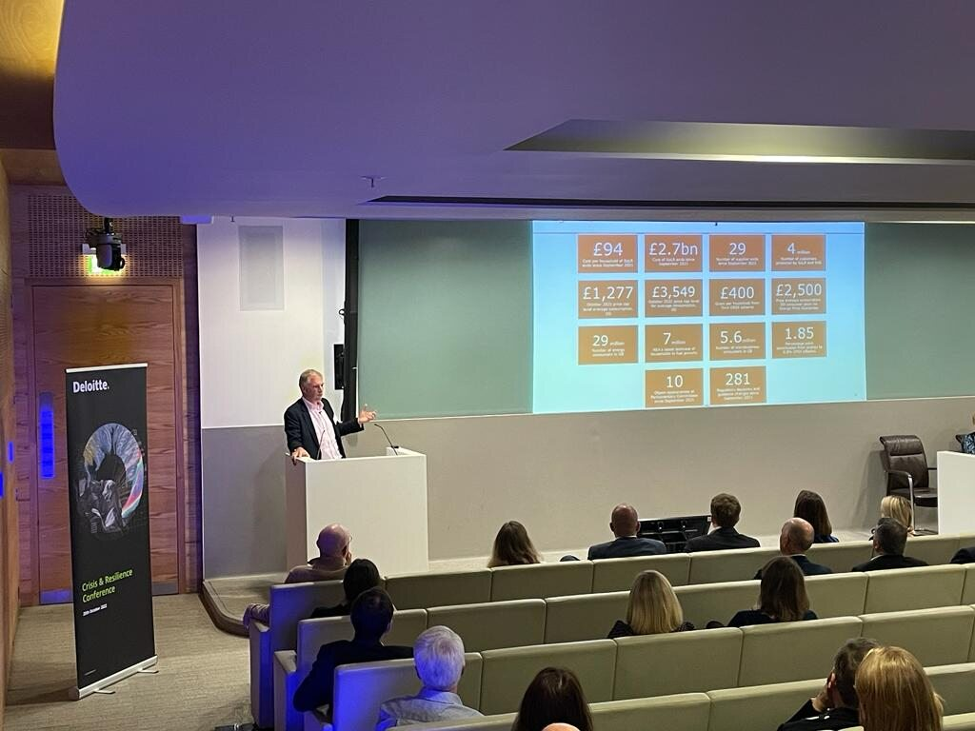

Executive Summary
Our Reputation as Market Leader – Recognition
A leading organization such as Salam can ensure that its resilience journey is set onto a successful and results-oriented path by partnering with an award-winning firm with proven experience.
Award Winning Performance
Deloitte Crisis & Resilience Conference
Forums & Community Partners
A member of our team of Professionals have been honored with the prestigious BCM & Risk Management award for his exceptional contribution at the GCC Security Symposium & CISO Awards 7th Edition in Riyadh in the Year 2023.
The winning organization of such awards offer a comprehensive array of solutions designed to help their clients evaluate their risks, determine acceptable levels of exposure and monitor the applications of these controls. For the past two decades, Deloitte has excelled in delivering business continuity, resilience and operational risk management solutions to a number of clients and redefined the standard of excellence in the BCM domain for the region.
Deloitte holds a yearly Crisis & Resilience conference which brings together leaders from across all aspects of resilience together.
The conference includes Gguest speakers who share inspiring stories, gives attendees the opportunity to network with industry peers and together shape the future thinking on organizational resilience.
This gives attendees an opportunity to join the conversation on themes including:
Delivering resilience at a geopolitical and macro level
Major event readiness – maintaining resilience while the eyes of the world are upon you
Spotlights on the five capitals of resilience: operational resilience; people resilience; environmental resilience; financial resilience; and reputational resilience.
Our resilience team members are members of professional communities such as the Business Continuity Institute’s (BCI) chapters and forums across the region, and regularly contribute to thought leadership across those platforms.
Our resilience team members are certified lead implementers and/or lead auditors of the ISO 22301:2019.
Conferences & Seminars
Our resilience leadership team are regularly invited to speak at conferences and seminars on areas in resilience and crisis management.

Slide 14
Executive Summary
Our Reputation as Market Leader – Awards
Recognized as 2023 Great Place to Work® in the UAE.
Recognized as 2023 Great Place to Work® in the KSA.
Brand Finance’s strongest and most valuable “commercial services” brand in the world 2022
Recognized as 2022 Great Place to Work® and Best Workplaces™ in the UAE
Ranked 7th in Fortune World’s Best Workplaces™ 2022
Recognized among “World’s Best Workplaces™ 2022” and “World’s Most Attractive Employers”
Gartner Magic Quadrant for Public Cloud IT Transformation Services placing highest on Ability to Execute and furthest on Completeness of Vision, 2022
Gartner Magic Quadrant™ for SAP S/4HANA Application Services, Worldwide, 2022
Leader in IDC MarketScape: Worldwide Managed Cloud Security Services. Multicloud Era Vendor Assessment, 2022
Gartner Magic Quadrant for SAP S/4HANA Application Services, Worldwide 2022
Deloitte ranked No. 1 consulting service provider worldwide by revenue. IDC MarketScape: Canadian Security Services 2019

Slide 15
Approach and Methodology
We believe in a service delivery approach that is driven by the client vision and expectation. We strive to provide global, end-to-end, innovative, and intelligent solutions tailored to priority industries and segments.
Subsequent section summarizes the approach performed by Deloitte to meet your expectation and objective.

Slide 16
Approach and Methodology
Key Phases and Deliverables
BCM Consultancy Services | 2 Years Engagement (2024 – 2025)
Phase 1: Project Initiation & Planning | Phase 2: Business Continuity Gap Analysis | Phase 3: Business Continuity Governance Framework | Phase 4: Business Impact Analysis | Phase 5: Business Continuity Risk Assessment | Phase 6: Business Continuity Recovery Strategy and Plans | Phase 7: Business Continuity Training & Awareness | Phase 8: Business Continuity Testing & Performance Monitoring | Phase 9: Business Continuity Internal Audit & Management Review
Ensure the objectives of the project are achieved in a timely and systematic manner. | Assess Salam’s current business continuity capabilities and identify the gaps as per ISO22301:2019 and best practices. | Develop a business continuity governance framework, leveraging existing capabilities and in alignment to the best practices and standards requirements. | Identify the impacts of business disruptions to the processes of Salam’s departments by conducting a Business Impact Analysis. | Identify the threats and the impacts on Salam’s operations by conducting a Threat Risk Assessment. | Identify and evaluate the most cost-effective and appropriate strategies to implement in case of a disruption. Develop recovery plans to ensure continuity of services. Develop the IT disaster recovery plan. | Conduct training and awareness sessions to educate Salam’s stakeholders on their BCM and CM roles and responsibilities. | Conduct exercise for BC Champions to familiarize themselves with their roles and responsibilities in the BCP. | Support Salam during internal audit. Support Salam in identifying non-conformities and corrective actions.
Project Charter Project Plan Presentation and approval from BCM committee | Findings, gap analysis and recommendations report Roadmap for implementation of agreed initiatives and actions | Business Continuity Framework Policy, procedures, and operations guidelines | BIA Templates BIA report for each function Consolidated BIA report Management Presentation | Business continuity risk register. Mitigation plans (in coordination with ERM) | BCM recovery strategy and solutions report Plan for effective implementation and monitoring Business Continuity Recovery Plans (BCPs) Incident Management Plan, Policy, and Procedures IT Disaster Recovery Plan Crisis Management and Communication Plan, sample transcripts, related policy and procedures | BCM Awareness and Training and Awareness materials In-person training sessions Material for E-Learning module (content only) | Test plans Two (02) BCP Tabletop exercises One (01) IMP, CMP and CCP Tabletop exercise One (01) Crisis Simulation (optional) Testing findings and recommendations reports | Support / conduct Internal Audit of the overall BCMS Program (outsourced or co-sourced, to be agreed). Internal audit report Presentation to client management
Phases
Objectives
Deliverables

Slide 17
Approach and Methodology
Phase 1: Project Initiation & Planning
“Successful results and smooth operations highly depend on quality planning, structuring, and implementation of supporting infrastructures. A forward-thinking consultant is a critical element in the success of this project.”
Approach
Our Project Methodology encompasses the following activities divided into five steps:
Step I – Project Initiation: Develop and sign-off an engagement letter to establish an agreement on the scope of work, approach and methodologies to be used. Furthermore, conduct a kick-off meeting with key stakeholders of the project and establish a project steering committee.
Step II – Project Planning: Develop a detailed project plan with timelines, resource allocation, deliverables, milestones and dependencies
Step III – Execution: Project activities will be performed according to project plan
Step IV – Monitoring and Quality Assurance: Reporting will be agreed as part of the planning phase whereby a status meeting will occur regularly with the project steering committee to outline the performance of the agreed program and achievement of key deliverables.
Step V – Project Closing: A closing meeting will be conducted with the project steering committee followed by a final sign-off and formal hand-over of all deliverables
Engagement Letter / Contract
Phase I - Initiation
Client Assistance Letter
Phase II - Planning
Project Plan
Kick-Off Meeting
Request for Information
Engagement Activities
Phase III - Execution
Meetings & Workshops
Status Reports
Phase IV - Monitoring
Internal Quality Assurance
Exit Meeting
Phase V - Closing
Management Sign-Off
Deliverables
Project Management
Meetings / Workshops
Fieldwork
Quality Assurance

Slide 18
Approach and Methodology
Phase 1: Project Initiation & Planning
We recognize that the quality service and advice we deliver enables our clients to make good decisions and protects their businesses and reputations. Quality is our passion - engrained in our culture and reinforced by our processes and systems. The cornerstone of quality in Deloitte is the caliber of our people and the consultative environment in which they work. Our client engagement will be led by Tariq Ajmal, Partner and Nader Farid as the Quality Assurance Partner who will take full responsibility for the quality of our service delivery.
Although an iterative process, there are three distinct phases to our Quality Program: Planning, Assurance and Control.
Quality Planning
Quality Assurance
Quality Control
Establish Templates and Procedures
Stakeholder Feedback
Accurate Deliverables
Meeting Expectations
Communicate Quality Standards
Quality Reporting
Document/Report Quality Issues
Define Client Expectations
Deliverable Review Process
Deloitte Quality Control Lead
This process identifies the quality standards that are expected by and relevant to Salam and determines how to fulfil them.
This process focuses on each deliverable meeting relevant quality standards; and is accomplished through peer reviews, client reviews, and product reviews.
This process monitors and manages quality issues so that compliance is maintained, including objective reports of quality issues to Deloitte leadership and Salam.
The Quality Control Plan depicted above has been designed to manage the quality of work through-out the duration of the engagement. The Quality Control Plan is based on a Quality Control framework that has been established by DTT member firms, refined through years of implementation, and has been successfully used by Deloitte professionals on large public and private sector engagements. This Quality Control Plan includes items specific to the needs with the ultimate goal of producing uniform, clear, concise, deliverables and work products of the highest possible quality throughout our length of service to Salam..

Slide 19

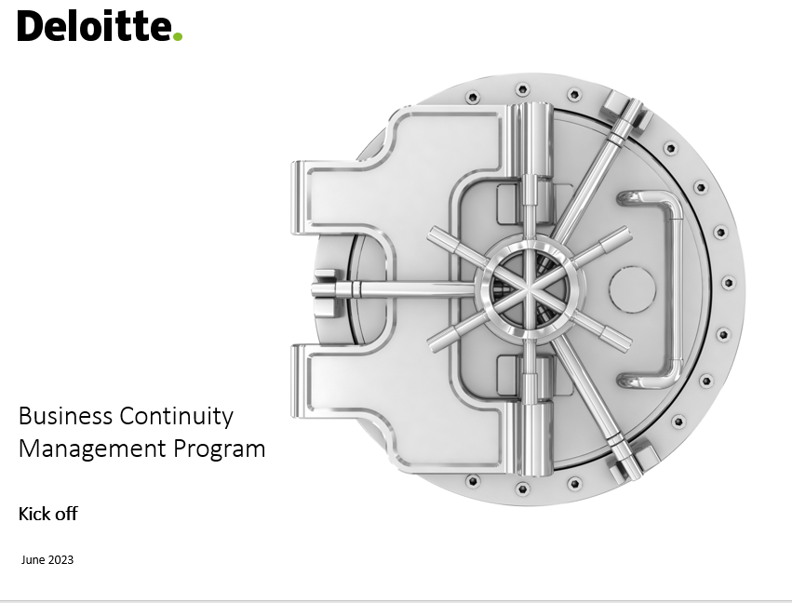
Approach and Methodology
Phase 1: Project Initiation & Planning
Deloitte will deliver a detailed project plan to ensure that Salam's needs are addressed, and all deliverables are taken into account during the project activities.
Key Activities
As part of Phase 1, Deloitte will leverage on its extensive experience in resilience to conduct the following activities:
Conduct kick-off meeting to agree on the project’s scope and objectives.
Identify key stakeholders and business key users to gain understanding of the BCMS environment.
Develop project plan to ensure adequate understanding of the deliverables and associated risks.
Request list of necessary documents to facilitate with the review.
Project Charter
Project Plan
Presentation and approval from BCM committee
Deliverables
For Illustration Purposes Only

Slide 20
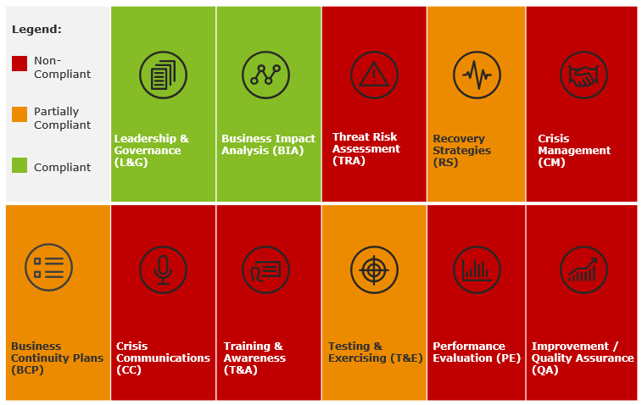
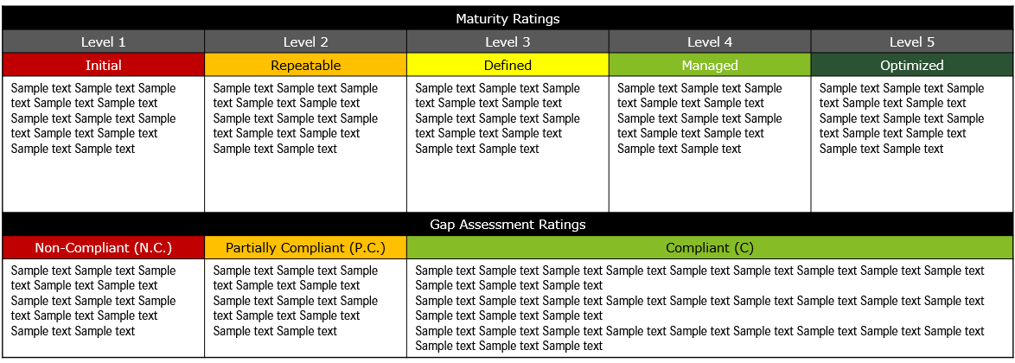
Approach and Methodology
Phase 2: Business Continuity Gap Analysis
To elevate the maturity of the BCMS, an assessment will be carried out using Deloitte’s proprietary Capabilities Assessment of Resilience, which is aligned with CST and ISO 22301 requirements.
Key Activities
Step 1: Review documentation
Review all existing BCM documentation, including BCM Policy, framework, procedures, Business Impact Analysis (BIA), Threat Risk Assessment (TRA), Operational and Strategic Plans against ISO requirements.
Step 2: Analysis
Identification of existing effective practices.
Analysis of any current areas requiring further development or maturity.
Identification of any vulnerabilities.
Identification of opportunities to align with ISO 22301 and CST requirements.
Step 3: Reporting
Overview of maturity level of the current BCMS.
Detailed overview of areas for improvement, including specific areas requiring additional development, research or adaptation.
Confirmation of areas of existing good practice to be maintained.
Development of a 3-year roadmap identifying key initiatives to achieve the desired maturity
Findings, gap analysis and recommendations report
Roadmap for implementation of agreed initiatives and actions
Deliverables
For Illustration Purposes Only

Slide 21
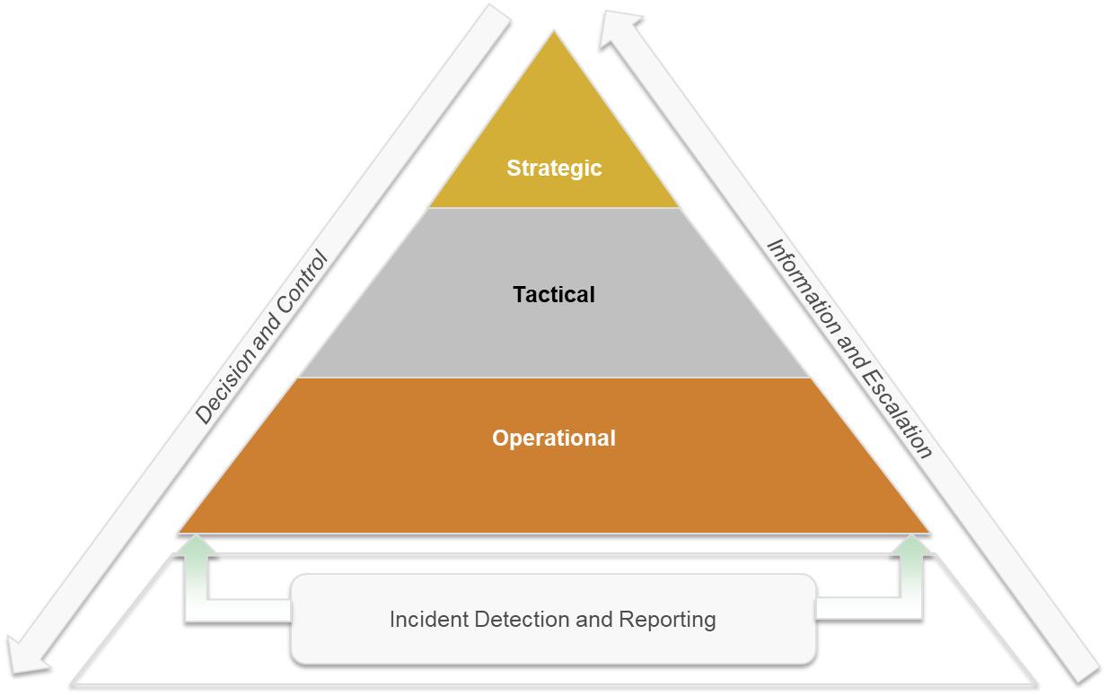
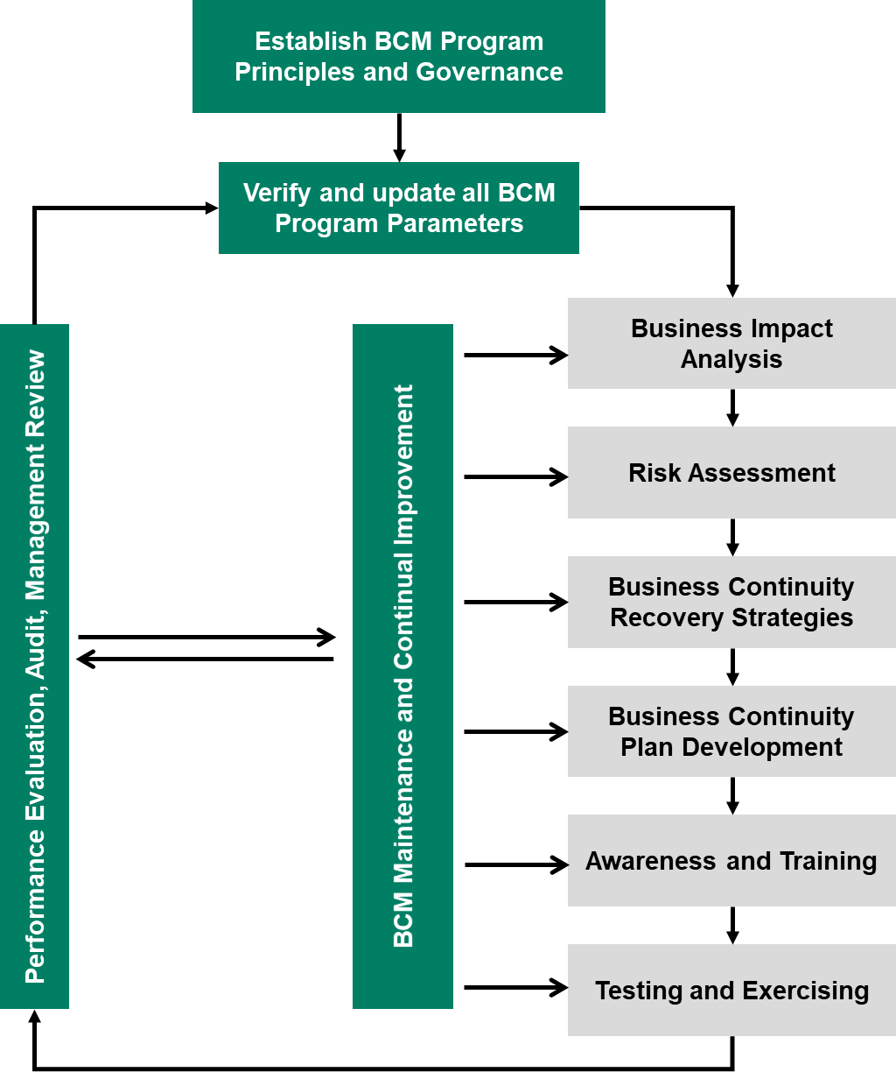
Approach and Methodology
Phase 3: Business Continuity Governance Framework
Develop a Business Continuity framework and assist in establishing policies, operations guidelines and procedures for management and maintenance of business continuity planning efforts. The BCMS model adopts a process-based approach to establish, implement, monitor and review the BCMS.
Key Activities
The purpose of this phase is to develop a Business Continuity Charter that will be followed while establishing the BCMS. Deloitte will support in defining the roles and responsibilities of Salam BCM team including the BCM Manager and supporting cross-functional team members from all time-critical departments, based on the ISO 22301 and CST requirements and considering the gaps identified during the Current State and Gap Assessment phase. Key outcome of this phase is the development of a Business Continuity Charter that includes the following:
Defining the scope and requirements of the BCMS.
Developing a Business Continuity Framework.
Defining the BCMS governance structure across Salam.
Defining processes, roles, responsibilities and line of authorities for the BCMS.
Business Continuity Framework
Policy, procedures, and operations guidelines:
Business Continuity
Disaster Recovery
Crisis Management
Deliverables
For Illustration Purposes Only

Slide 22
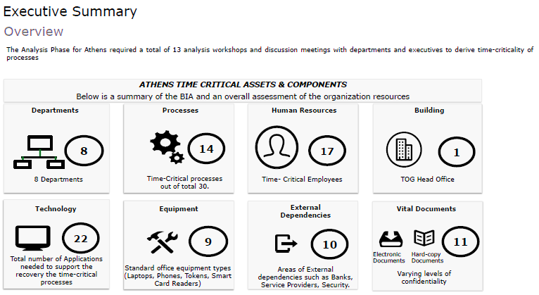
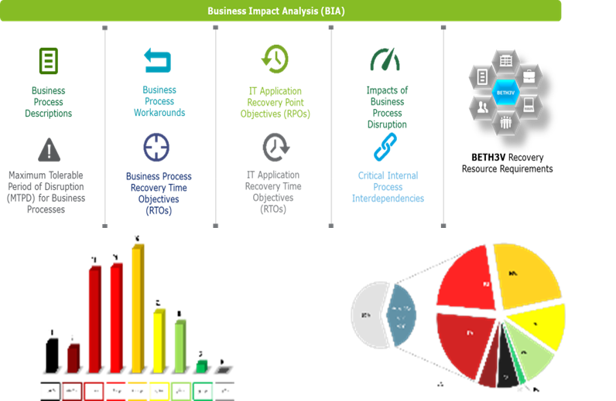
Approach and Methodology
Phase 4: Business Impact Analysis (1/2)
Utilizing our trademark BETH3V methodology to identify the resource requirements during the BIA exercise. Our methodology allows us to use impact-driven approach to identify the resources required to continue the mission-critical activities.
Key Activities
We will be utilizing our trademark BETH3V™ methodology to identify the resource requirements during the Business Impact Analysis (BIA) exercise.
BIA identifies the consequences of business interruption and evaluates business impacts by measuring the Quantitative (financial) and Qualitative (operational, reputational and regulatory etc.) impacts associated with a disruption of the normal operations of an organization. As part of this phase, we will:
Review the business processes documentation that support the various departments;
Identify impact of disruption on quantitative and qualitative matrices and identify the Maximum Tolerable Period of Disruption (MTPD) and Recovery Time Objective (RTO);
Identify the BETH3V process enablers (i.e. Building, Equipment, Technology, Human Resources, 3rd Party and Vital Records) that would be required to recover the time critical processes;
Identify the external and internal dependencies of time critical business processes as well as required technologies, personnel, workspace and equipment in order to analyze the overall impact of outages to determine the appropriate recoverability investment;
Document the outcomes in a Consolidated BIA Report
We will utilize the impact rating matrix and risk appetite set by the Risk Management function of Salam. In case its not available, we will propose an Impact Rating Matrix template to be utilized by Salam Management; however, actual metrics/thresholds shall be provided by Salam Management.
BIA Templates
BIA report for each business function (max. 12)
Consolidated BIA report
Management Presentation
Deliverables
For Illustration Purposes Only

Slide 23









Approach and Methodology
Phase 4: Business Impact Analysis (2/2)
We understand that one size does not fit all in terms of conducting a Business Impact Analysis (BIA). We appreciate that each industry is unique, and accordingly, we customize our BIA approach for each environment. The below diagram represents the BIA that we will conduct for Salam.
Business Impact Analysis (BIA)
Business
Process
Descriptions
Business
Process Workarounds
IT Application Recovery Point Objectives (RPOs)
Impacts of Business Process Disruption
BETH3V
BETH3V
Maximum Tolerable Period of Disruption (MTPD) for Business Processes
Business Process Recovery Time Objectives (RTOs)
IT Application Recovery Time Objectives (RTOs)
Critical Internal Process Interdependencies
BETH3V Recovery
Resource Requirements
Building, Equipment, Technology, Human Resources, 3rd Parties, Vital Records

Slide 24
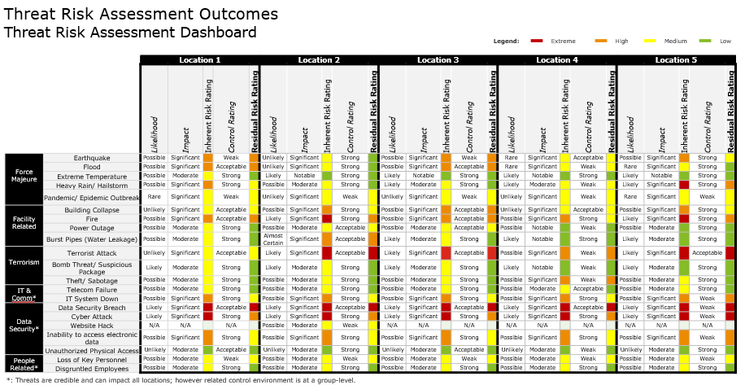
Approach and Methodology
Phase 5: Business Continuity Risk Assessment
Identify and assess threats to Salam's normal activities through questionnaires and workshops with stakeholders to gauge their likelihood, severity, and impact.
Key Activities
This activity will be conducted for the Riyadh HQ and Dubai offices. As part of this step, we will:
Identify the threats, the possible likelihood, the probability of occurrence of the identified threats and the potential impact of the threat.
Identify risks associated with various asset categories defined in BETH3V: Buildings, Equipment (hardware), Technology (software), Human Resources, 3rd parties (stakeholders), and Vital Records.
Identify the existing physical and environmental mitigating controls / measures.
Measure the risk exposure level before and after the recommended mitigating measures have been implemented using a qualitative approach (ranking method).
Recommend additional mitigating controls/measures to bring down risks to an acceptable level.
Business continuity risk register
Mitigation plans (in coordination with ERM)
Deliverables
For Illustration Purposes Only

Slide 25
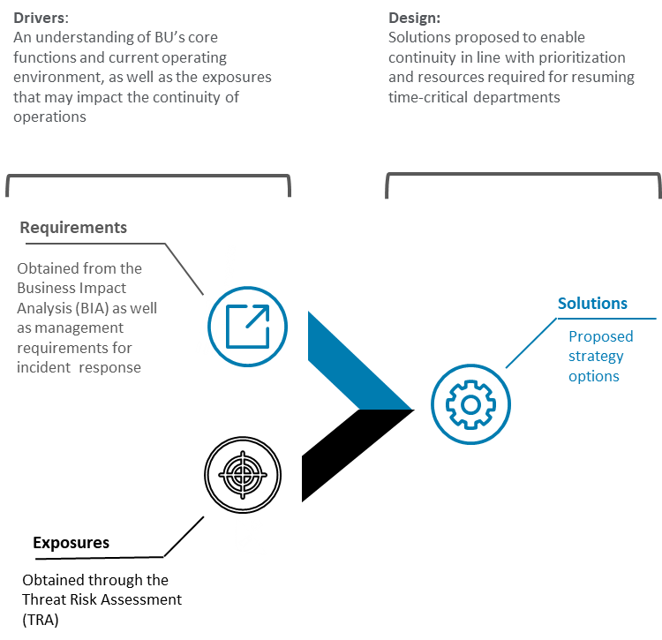
Approach and Methodology
Phase 6: Business Continuity Recovery Strategy and Plans (1/5)
Provide strategic options to recover Salam’s critical processes and services by identifying and evaluating the most cost-effective and appropriate strategies based on the outcomes of the Business Impact Analysis and the Threat Risk Assessment.
Key Activities
Provide strategic options to recover the time-critical processes by identifying and evaluating the most cost-effective and appropriate strategies based on the outcomes of the Business Impact Analysis and the Threat Risk Assessment.
To provide BCM recovery strategy options, we will do the following:
Identify fit-for-purpose recovery strategies in case of unavailability of the BETH3V components;
Evaluate the recovery options to ensure they provide the minimum acceptable level of service for key BCMS metrics – such as within the defined maximum tolerable period of disruption (MTPD) and recovery time objective (RTO) timeframe as well as recovery point objective (RPO);
Present the recovery strategy options for the time-critical processes to the BCM Steering Committee; and
Recommend, based on hierarchical tiers, the most cost-effective strategy option and obtain management approval of the selected options.
BCM recovery strategy and solutions report
Plan for effective implementation and continuous review of the identified BCM strategies
Deliverables
For Illustration Purposes Only

Slide 26
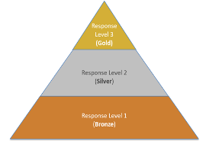
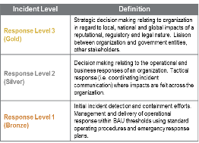
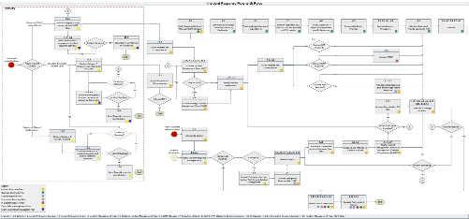
Approach and Methodology
Phase 6: Business Continuity Recovery Strategy and Plans (2/5)
Develop an Incident Response Plan (IRP) to establish a structured and systematic process for responding to incidents of varying severity that may impact Salam at an operational and tactical layer.
Key Activities
This step involves development of the Incident Management Policy and Plan, which will include the following :
Understand the current Incident Response structure (if any) at Salam.
Define the varying levels of severity for distinguished incidents and accordingly deploy the appropriate teams and resources to handle the situation by:
Specifying the Incident Response Team (IRT) structure.
Specifying the incident response procedures for detection, notification, assessing incident severity, escalation and deactivation.
The document will:
Contain procedures to mobilize and deploy internal and external resources.
Provide guidance for the immediate response to incidents, prioritizing the safety and wellbeing of people.
Oversee execution of response activities and provide guidance as appropriate.
Document internal and external communication procedures and protocols.
Incident Management Plan, Policy and procedures.
Deliverables
For Illustration Purposes Only

Slide 27
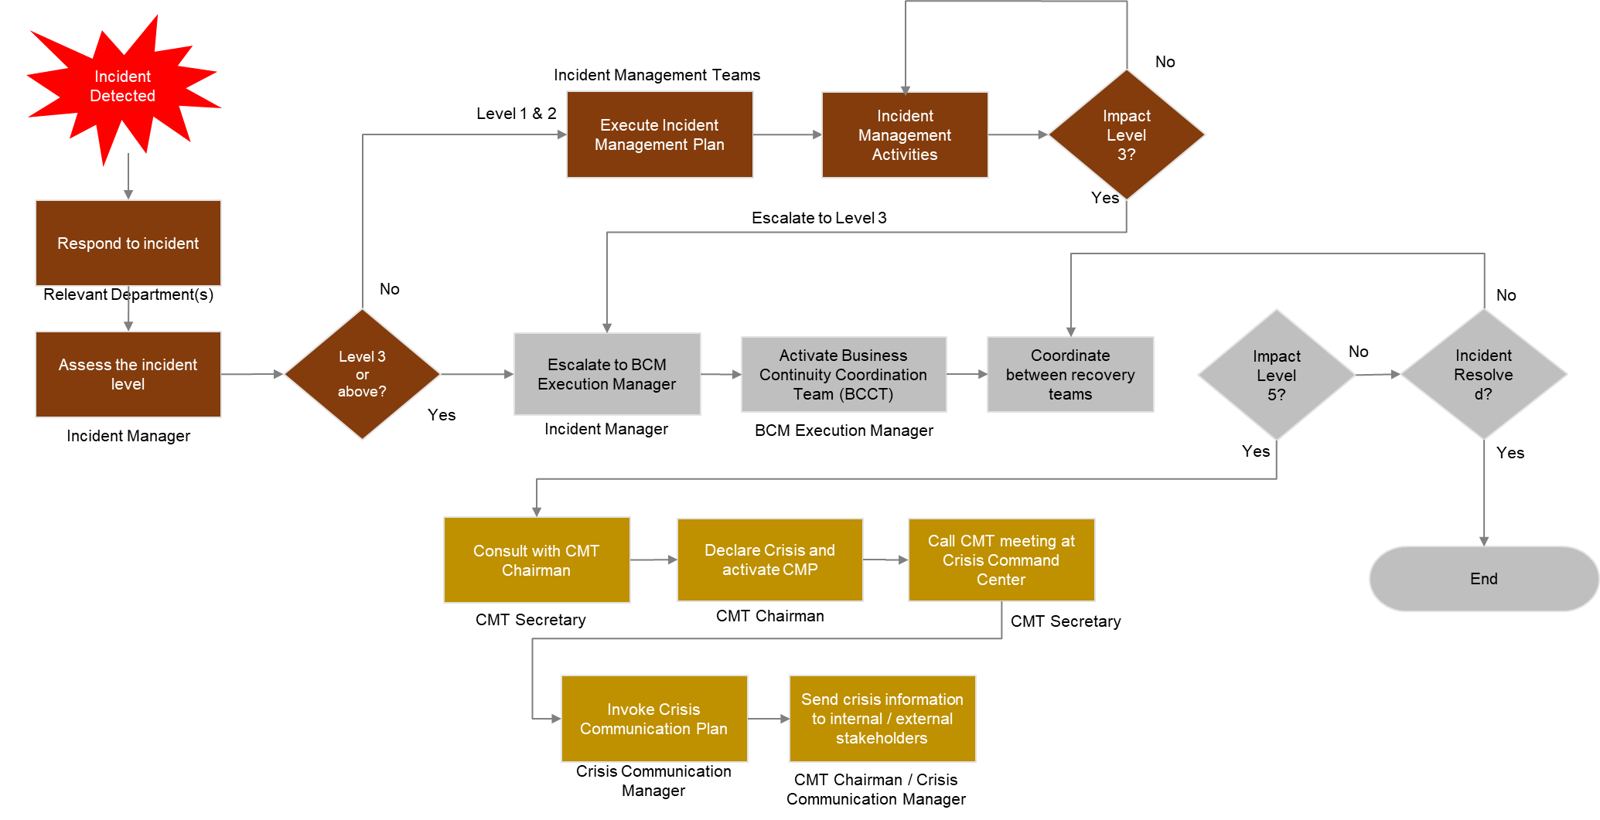
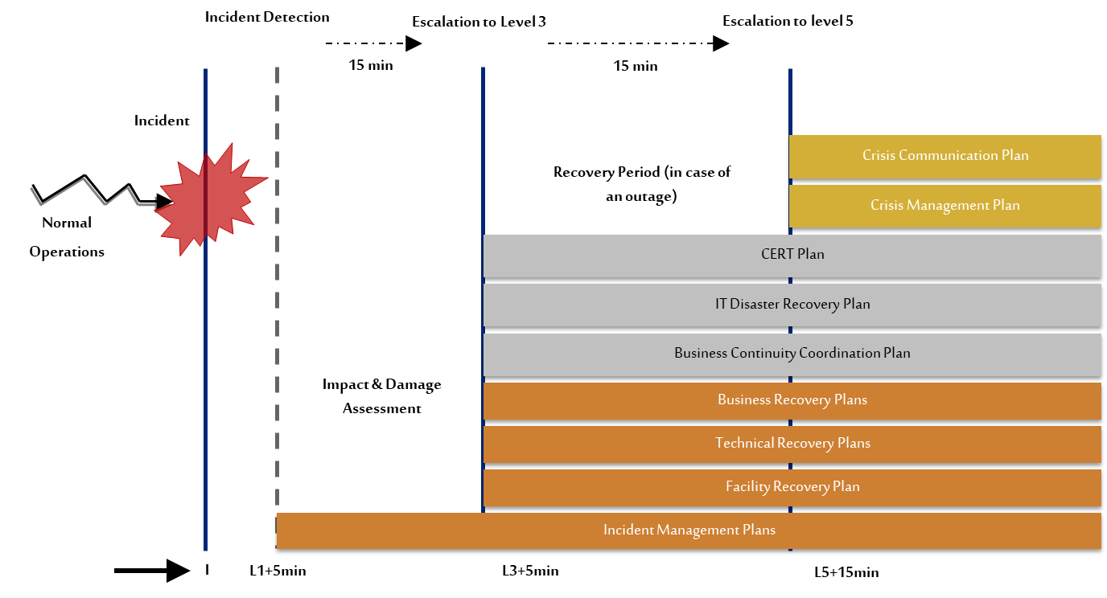
Approach and Methodology
Phase 6: Business Continuity Recovery Strategy and Plans (3/5)
Develop a Crisis Management & Communication Plan to establish a structured and systematic process for responding to incidents of varying severity that may significantly or strategically impact Salam.
Key Activities
The Crisis Management & Communication Plan will:
Develop Crisis Management structures with roles and responsibilities.
Specify response procedures including declaration of crisis, activation of crisis command center and relationship between departments on crisis management.
Contain procedures to mobilize and deploy internal and external resources.
Include guidelines for overseeing execution of response activities and providing guidance as appropriate.
Outline the approval process for sending messages to external parties concerning the crisis.
Document internal and external communication procedures and protocols.
Identify appropriate channels for communication.
Contain procedures for invoking and deactivating the BCPs, as necessary.
Crisis Management and Communication Plan, sample transcripts, related policy and procedures
Deliverables
For Illustration Purposes Only

Slide 28
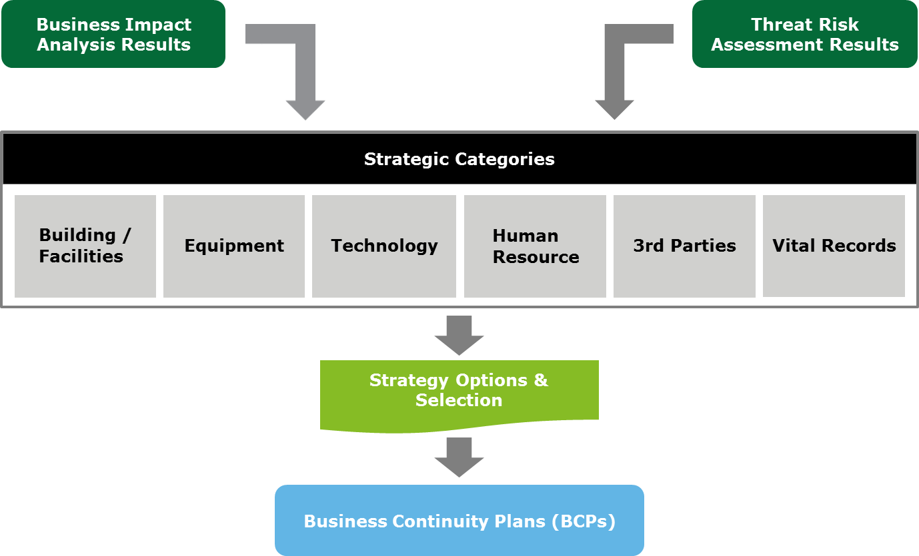
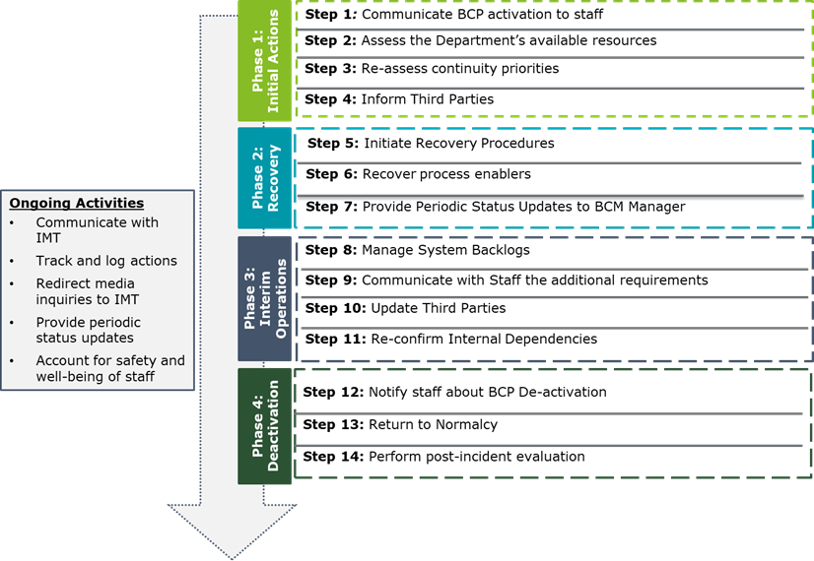
Approach and Methodology
Phase 6: Business Continuity Recovery Strategy and Plans (4/5)
Develop departmental Business Continuity Plans (BCP) for time-critical departments providing priority services and processes.
Key Activities
As part of this step, we will Develop Business Continuity Plans (BCPs) for Salam’s time-critical departments providing priority business processes. The BCPs will:
Provide detailed guidance on required actions during and following a disruption
Specify the resources, and personnel required to respond to a disruptive event
Outline the sequence of recovery services and processes
Involve relevant Salam leadership and key personnel in recovery of operations.
Provide a comprehensive step by step procedure to the stabilization and return to normal phase
Align the BCPs with the capabilities of the disaster recovery site by developing clear tasks with clear beginnings and end points to report to operations executives for managing recovery-effort progress, including:
Identifying tasks to be undertaken,
Teams to complete them,
Team assignments and
Identifying the key contacts, suppliers and resources necessary to support the recovery.
Business Continuity Recovery Plans (BCPs) for time-critical departments (max. 12)
Deliverables
For Illustration Purposes Only

Slide 29
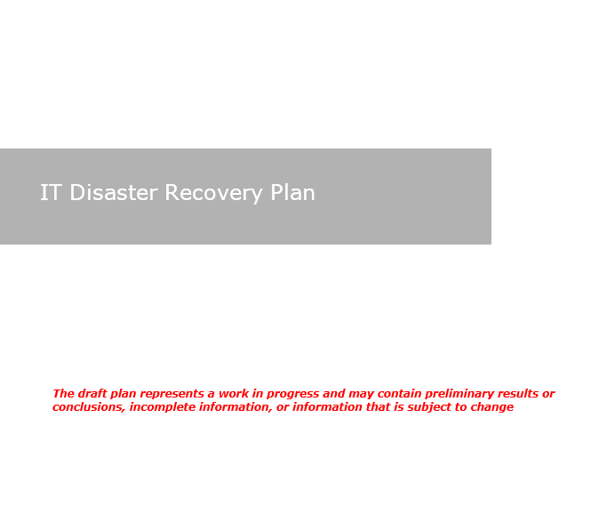
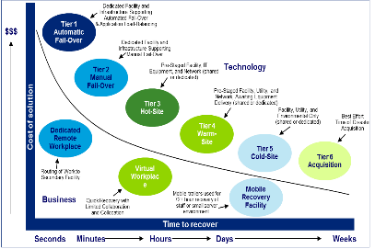
Approach and Methodology
Phase 6: Business Continuity Recovery Strategy and Plans (5/5)
Develop an ITDR Plan to establish a structured and systematic process for responding to incidents of varying severity that may significantly or strategically impact Salam’s IT environment.
Key Activities
This phase involves development of an ITDR plan which will ensure the following are accurately included:
Scope of the plan including the critical IT Services.
Information about related applications and infrastructure.
Division of in-scope IT Services and underlying infrastructure into multiple tiers. This will be based on the corresponding Recovery Time Objectives (RTOs) and Recovery Point Objectives (RPOs), as agreed with Business.
Phases that form the basis of ITDR process.
Communication protocols with interested parties (internal and external) including contact details.
Document the IT Disaster Declaration criteria. This can be based on existing criteria or developed in coordination with Salam team.
Alignment of ITDR plan with the overall BCM framework of Salam.
Ownership of role/team who will be responsible for keeping the plan up to date.
IT DR Governance Structure.
Roles and responsibilities of ITDR Management team and the requirement for periodic updates of IT DR plan.
Our scope does not include development of any recovery procedures, runbooks or scripts. Deloitte assumes that run books and technical procedures are the responsibility of the IT team and technology vendors.
IT Disaster Recovery Plan
Deliverables
For Illustration Purposes Only

Slide 30
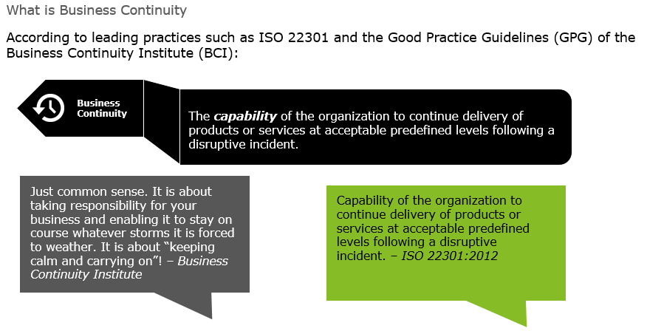
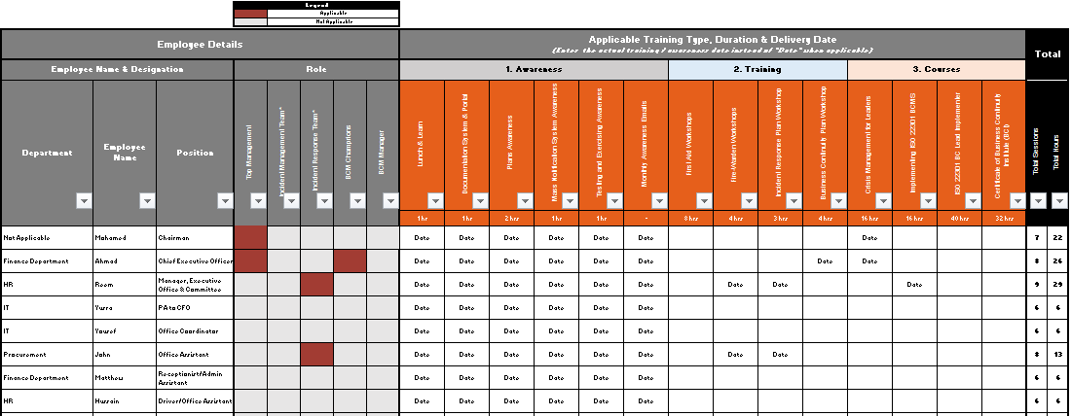
Approach and Methodology
Phase 7: Business Continuity Training & Awareness
Essential pillar in the BCM program is to promote the vision and purpose of Salam’s BCM Program and its benefits to key stakeholder groups.
Key Activities
The aim of this phase is to promote the vision and purpose of Salam’s BCMS and its benefits to various stakeholder groups. We will do this through the following:
Propose a BCM Awareness and Training Program covering methodologies and approach, subjects and areas, types and channels, criteria / maturity measurements and levels, objectives, target audiences, RACI with HR and corporate & communication.
Develop BCM awareness and training materials (awareness emails, screensaver messages, poster, presentations)
Conduct one (01) BCM awareness session for general staff.
Conduct one (01) training session for BCM Committee (C-suite) covering key governance activities, crisis management and crisis communication aspects, etc.
Conduct two (02) training sessions for BCM Champions to train them on all BCMS components and key plans
Develop awareness material (content only) that will be used by Salam to develop an e-learning module.
Deloitte will not be responsible in developing the e-learning module (e.g. SCORM file). Deloitte will provide the content only that may be used by Salam.
BCM Awareness and Training Program
BCM Awareness materials (4 awareness emails, two posters, 2 screensaver messages)
One (01) BCM awareness session for general staff
One (01) training session for BCM Committee (C-suite) covering key governance activities, crisis management and crisis communication aspects, etc.
Two (02) training sessions for BCM Champions to train them on all BCMS components and key plans
Material for E-Learning module (content only)
Deliverables
BCM Policy
BIA
Strategy & Plans
For Illustration Purposes Only
Training & Awareness

Slide 31
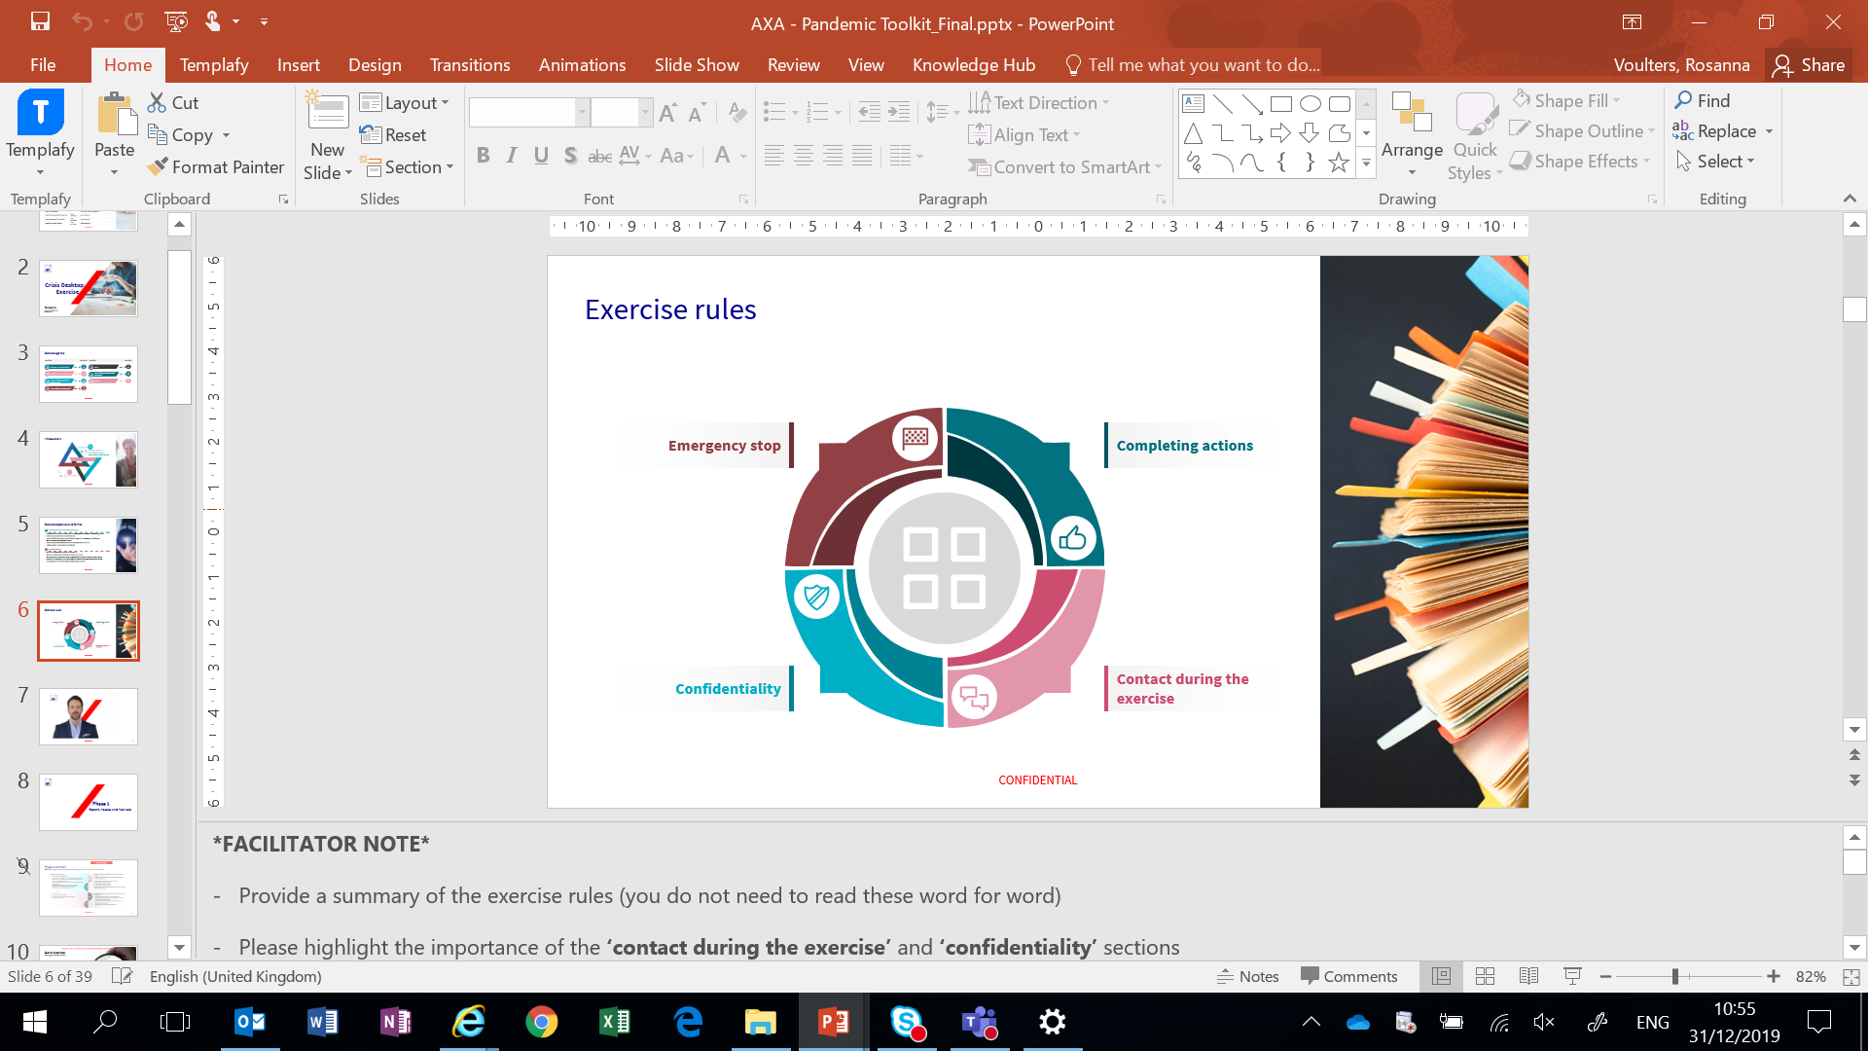
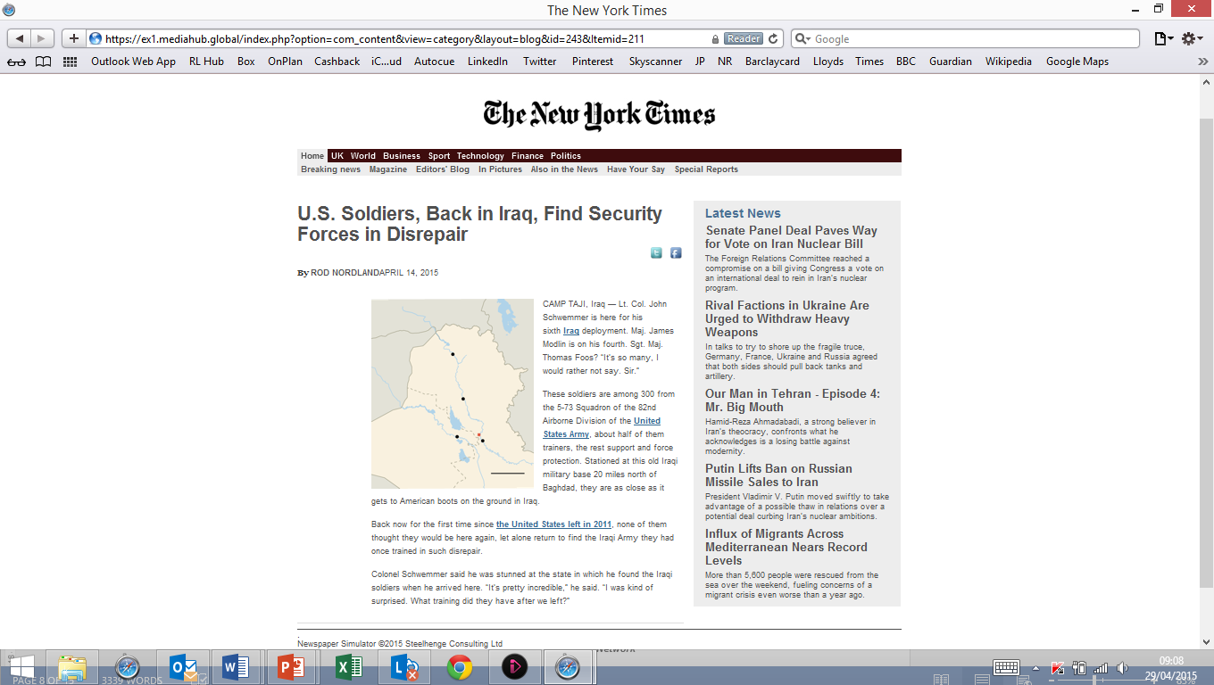

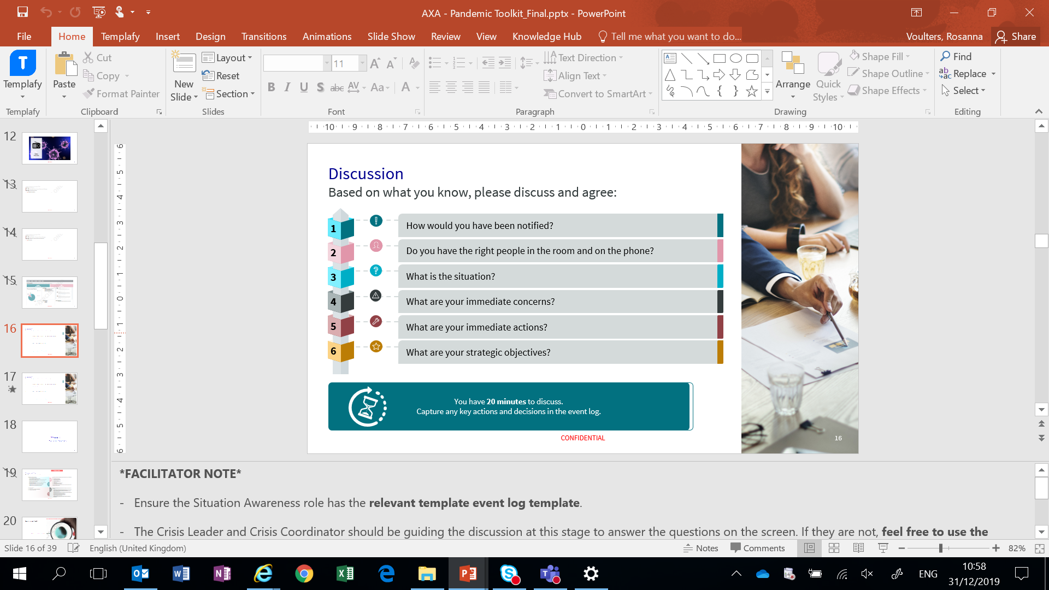

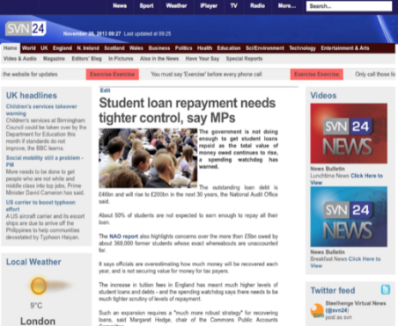
Approach and Methodology
Phase 8: Business Continuity Testing & Performance Monitoring
In order to prepare Salam and its critical departments to execute their BCPs, we will exercise these plans using relatable approaches and plausible scenarios. We will prepare and facilitate a tabletop exercise for key stakeholders.
Key Activities
Develop a BCM Exercising Program for Salam that defines a progressive model for increasing the maturity of exercising conducted on a periodic basis. The program will include a definition of the exercise types, recommended execution frequency, objectives, plan(s) to be exercised, location(s) to be covered, as well a definition of the relevant roles and responsibilities required for designing and executing test(s) / exercise(s).
In line with the progressive maturity model defined in the Exercising Schedule, we will design different test scenarios covering key threats and risks identified during the risk assessment phase.
We will conduct two (02) tabletop exercises for BCPs and one (01) tabletop for IMP, CMP and CCP.
Should Salam opt to choose a crisis simulation, we will conduct a crisis simulations covering IMP, CMP and CCP.
Provide post-exercise report for documenting observations during the exercises and highlighting strength and opportunities to improve.
Deloitte will not cover any IT DR failover exercise as part of the testing / exercising activities.
BCM Exercising Program
Four (4) Test plans
Two (02) BCP Tabletop exercises
One (01) IMP, CMP and CCP Tabletop exercise
One (01) Crisis Simulation (optional)
Testing findings and recommendations reports
Deliverables
For Illustration Purposes Only

Slide 32
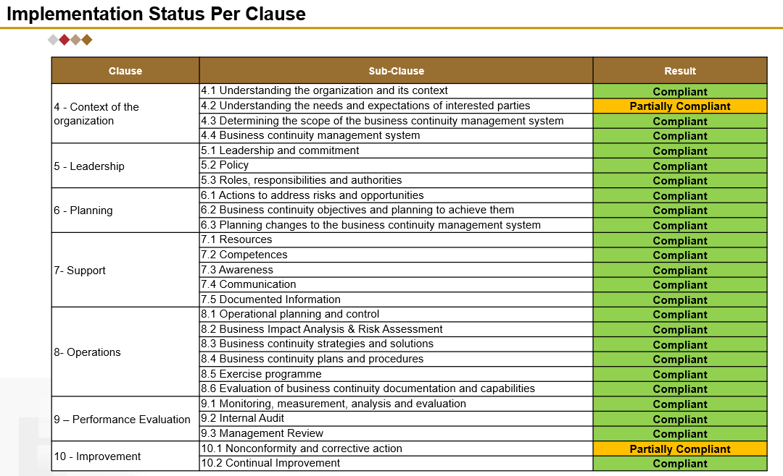
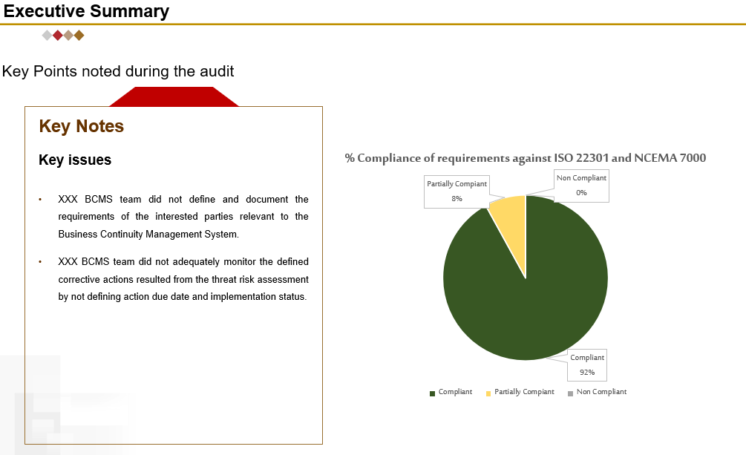
Approach and Methodology
Phase 9: Business Continuity Internal Audit & Management Review
Deloitte will provide support to Salam during internal audit to ensure the efficiency of resilience procedures and their conformity to standard operating procedures as well as government regulations.
Key Activities
As part of Phase 7, Deloitte will perform the following activities:
Prepare the necessary documentation and records that are expected to be reviewed by the external certification body as well as the internal audit team.
Assist auditors during internal / external audits in gathering the necessary evidence and guide them in identifying the appropriate corrective actions.
Create and update a corrective-action tracker in which our consultant will report any identified non-conformity and the relevant corrective action.
Ensure that Salam tackles every non-conformity and advise on implementing all corrective actions in a timely manner.
Support / conduct Internal Audit of the overall BCMS Program (outsourced or co-sourced, to be agreed).
Internal audit report
Presentation to Salam management
Internal Audit Report Template – KPI Reporting
Deliverables
For Illustration Purposes Only
Internal Audit Report Template

Slide 33
Project Timeline
Deloitte has developed a streamlined approach to assist Salam in addressing its requirements. We expect to mobilize our team of consultants in two (02) weeks after signing the engagement letter and anticipate that it will require 6 months to execute the project, followed by the secondment period based on the delivery model selected by Salam.

Slide 34
Timeline
Project Execution Timeline
The following is a representative project timeline for the project. We estimate that the engagement will be completed over 6 months period, followed by secondment of BCM Expert.
Project Phases | Month 1 |  |  |  | Month 2 |  |  |  | Month 3 |  |  |  | Month 4 |  |  |  | Month 5 |  |  |  | Month 6
 | W1 | W2 | W3 | W4 | W5 | W6 | W7 | W8 | W9 | W10 | W11 | W12 | W13 | W14 | W15 | W16 | W17 | W18 | W19 | W20 | W21 | W22 | W23 | W24
Phase 1: Project Initiation
Phase 2: Business Continuity Gap Analysis
Phase 3: Business Continuity Governance Framework
Phase 4: Business Impact Analysis
Phase 5: Business Continuity Risk Assessment
Phase 6: Business Continuity Recovery Strategy and Plans
Phase 7: Business Continuity Training & Awareness
Phase 8: Business Continuity Testing & Performance Monitoring
Phase 9: Business Continuity Internal Audit & Management Review
Delays caused by Salam personnel will be monitored and brought to Salam management’s attention as part of the engagement management reporting processes. These delays may add to the total number of man-days required to complete the engagement. In this case, Deloitte reserves the right to pass on any additional fees / costs that are linked to these delays. We will notify you promptly of any circumstances we encounter that could significantly affect our estimate.

Slide 35
Our Team
Members of our core team have prior experience with similar organizations and have relevant certifications.
We believe it is all about people who make the difference. Therefore, we have carefully structured a multidisciplinary team which has the required technical skills, industry knowledge and previous experience of working on similar projects.

Slide 36
Our Team
Engagement Leadership
Roles | Responsibilities
Engagement Leadership | Overall responsibility for planning, coordination and delivery of project outputs. Identify and assign appropriate resources to the project.
Engagement Management and Subject Matter Experts | Ensure objectives are met within timing and scope outlined. Manage day-to-day activities. Provide regular status updates to respective management as required.
Subject Matter Expert (SME) | Provide guidance on the challenges and complicated topics.
Core Team | Perform fieldwork under direction of Engagement Manager. Prepare deliverables draft Seconded resource will be available onsite for the no. of working days per month mutually agreed between Deloitte and Salam.
Quality Assurance Partner
Engagement Partner
Engagement Leader
Nader Farid
Partner
Tariq Ajmal
Partner
Maarten Smulders
Director
Engagement Management and Subject Matter Experts
Subject Matter Expert
Engagement Manager
Subject Matter Expert
Arsalan Yousuf
Director
Esam Shana’a
Senior Manager
Syed Waqi Hasan
Senior Manager
Core Team
Varsha Sastry
Senior Consultant
Abdulrahman Almasri
Consultant
Ibrahim Almoudaifer
Business Analyst
Deloitte Resource Pool
Deloitte Resource pool - Deloitte is the largest integrated risk consulting practice in the Middle East with more than 250 professionals. These resources can be further augmented by regional and global professionals and Subject Matter Experts (as needed); however, the SMEs are not expected to be onsite.
Deloitte reserves the right to adjust the engagement team and subject matter experts based on the exact engagement start, planning and the availability of our engagement team members.
36

Slide 37
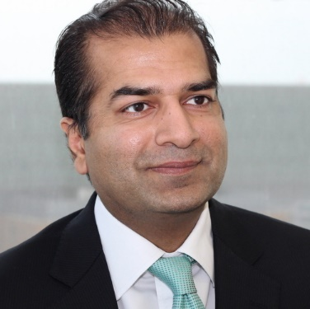
Engagement Partner
Tariq has more than 20 years of experience in the field of Information & Technology Risk covering IT Governance, Project Risk, Cyber Security, Resiliency & Crisis Management, IT and Business Process Controls as well as helping organization comply with requirements such as Sarbanes Oxley, ISO, CobiT, ITIL, ADSIC, etc. Tariq’s experience spans various industries and clients in Middle East and North America.
Key Relevant Engagements – Outline
Tariq has performed, managed and directed engagements in a wide range of data processing environments, ranging from highly complex mainframe systems to stand alone PC and LAN based systems. His project experience includes:
IT Governance assessments and implementations (including IT Risk Management, Project and Portfolio Management, IT and Business Alignment, IT Compliance Management).
IT control design and risk identification / mitigation reviews.
Business process reviews covering both operational and support processes.
Third party reviews and reporting (such as SAS 70 / SSEA16, CICA Sec. 5900, ISAE 3402 / ISAE 3000 / WebTrust etc.) for outsourced business processes and infrastructure.
Application (SAP, Oracle, JD Edwards, Great Plains, People Soft, Baan, Maximo, Banking, Insurance, Telecom etc.) pre and post implementation reviews covering application functionality controls, security controls (technical and segregation of duties) and implementation project reviews.
Database (Oracle, SQL), operating systems / platforms (IBM Mainframe, RACF, Top Secret, AS400, Windows, UNIX, etc.) and network configuration and security reviews.
Data conversion reviews including data quality and integrity reviews.
Development and implementation of Integrated Management System (IMS) based on PAS99 covering various ISO standards such as ISO14000 (Environment), OHSAS18000 (Health & Safety), ISO20000 (IT Service), ISO27001 (Information Security) and ISO22301 (Business Continuity Management).
Tariq M. Ajmal Partner
Professional and Technical Qualification
CISA - Certified Information Systems Auditor, Member Information Systems Audit and Control Association (ISACA), USA
CGEIT - Certified in the Governance of Enterprise IT, ISACA
CA - Chartered Accountant (Canada), Member Canadian Institute of Chartered Accountants (CICA), Canada
MMPA - Master of Management & Professional Accounting, Rotman School of Management University of Toronto, Toronto
B. Com. Joint Honours in Economics and Accounting, McGill University, Montreal
Key Clients Saudi Central Bank (SAMA) stc Group stc Solutions stc Channels Abu Dhabi Investment Authority - UAE Abu Dhabi National Oil Company (ADNOC) ADGAS | GASCO Dubai Financial Services Authority (DFSA) – UAE Emirates NBD National Bank of Abu Dhabi – UAE Mubadala – UAE Qatargas RasGas

Slide 38
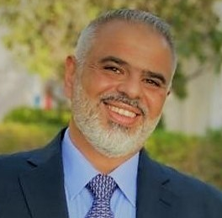
QA Partner
Nader is a Partner in Risk Advisory leading Cyber and Technology Risk practice in KSA. Nader has more than 20 years of experience in the field of Information Security & Technology Risk covering IT Governance, IT Risk Management, Information Security Management, Infrastructure & Operations Security, Business Continuity and ERP Process Controls.
Nader has led and managed a wide range of Information Technology and Security Risk Management engagements for a number of iconic clients in the ME across various industries including; Financial Services, Manufacturing, Utilities, Telecoms and the Public Sector.
Nader Farid
Partner
Key Relevant Engagements – Outline
Nader has been involved in various engagements related to end to end information security programme covering current state assessment; strategic and technical risk assessment; strategy and roadmap; governance; policies and procedures, business continuity management; training & awareness; and testing. Some of his relevant project experience includes:
Project Manager for the Business Continuity and Disaster Recovery assessment and documentation for one of the world’s largest National Oil Companies.
Led the SAP Post implementation and Cyber security review for a leading chemicals manufacturing client in KSA. The areas in scope included, IT Governance, IT Operations, ERP automated controls, user access and IT Security (vulnerability assessment and attack & penetration).
Led the IT Internal Audit and Applications Controls review for a leading utilities company based out of AL-Jubail Industrial City, KSA. The scope encompassed review of IT Governance, IT Security as well as ERP functional and user security Controls.
Led an IT internal audit co-sourcing engagement for a leading telecom service provider in the Kingdom Bahrain covering IT, Networks and ERP systems Audits.
Led several internal audit outsourcing engagements for a number of leading clients in KSA. Some of the key areas covered during these engagements include; Finance & Accounts, Revenue & expenditures, HR & Admin, Procurement, Patient Services, as well as IT and Cyber Security.
Project Manager for a large transformation engagement for a leading Paper Manufacturing client in Saudi Arabia. The scope encompassed Strategy Articulation, Organization restructuring as well as development of the client’s Process, Policies & procedures, and Compensation schemes.
Professional and Technical Qualification
Bachelor of Science Degree in Computer Information Systems from California State University of Fresno, USA.
Certified Information System Auditor [CISA].
Certified in Risk and Information Systems Control [CRISC]
Member of the Information Systems Audit and Control Association (ISACA)
Key Clients SAMBA – KSA Bank AlBilad – KSA NCB - KSA AlAwal Bank – KSA Saudi Aramco – KSA | ELM – KSA NADEC – KSA STC -KSA Bupa Arabia – KSA Al-Jazira Takaful - KSA

Slide 39
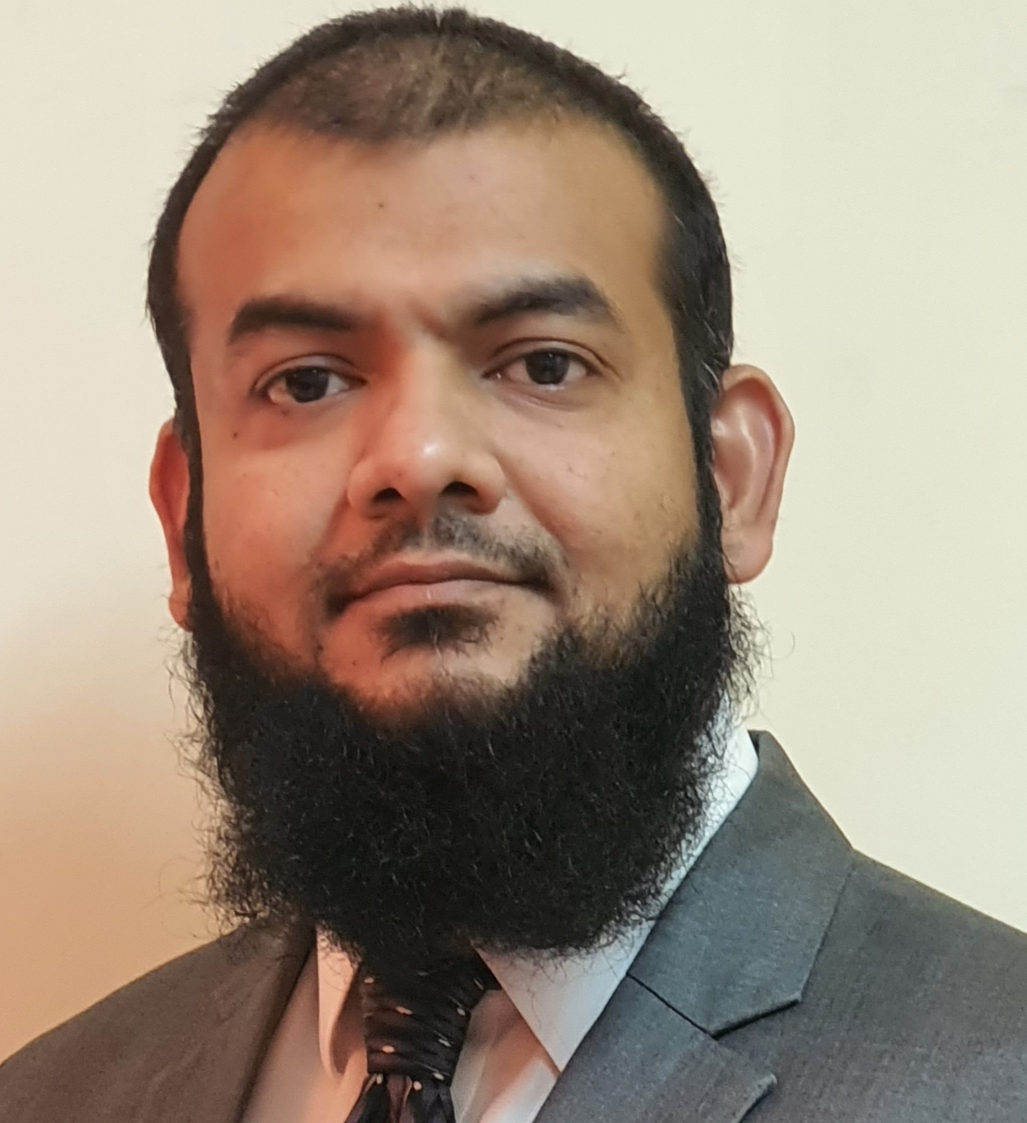
Engagement Leader
Arsalan is Director in Deloitte’s Cyber and Strategic Risk Advisory Services practice based in Riyadh. With an overall experience of 18+ years, he has in-depth knowledge & experience in the field of Crisis Management, Resiliency and Business Continuity, working on several different engagements for development, implementation and assessment of BCM based on ISO 22301, ISO 22361, BS 67000, SAMA BCM Framework and industry best practices. Arsalan holds a Masters’ Degree in Computer Science, and industry recognized certifications like Certificate of the BCI (CBCI), Certified Information Security Manager (CISM) and Certified Information Systems Auditor (CISA).
Key Relevant Engagements – Outline
Arsalan has led several key business continuity engagements in different sectors including Banking, Financial market, Oil & Gas, etc. Key experience includes:
Engagement Leader for Business Continuity Management Program at one of the largest payment infrastructure provider in Middle East
Engagement Leader for BCM & DR Development at the leading digital wallet payments in KSA
Engagement Leader for an end-to-end BCMS development project for technology service provider in KSA
Engagement Manager for enhancement of BCM Program for the largest stock exchange in the middle east
Engagement Manager for development and implementation of end-to-end Business Continuity Management Program for one o the G20 central bank
Subject Matter Expert for the development of IT BCM Program for a large commercial bank in KSA
Engagement Manager for Development and implementation of end-to-end Business Continuity Management Program for a government authority in Bahrain
Subject Matter Expert for Development of end-to-end BCM Program at the largest insurance organization in KSA
Core team member for Business Continuity Enhancement Project (BCEP) at leading LNG company in Qatar assisting the organization in revamping its BCM Program
Arsalan Yousuf
Director
Professional and Technical Qualification
MS Computer Science & Networks – National University of Computers & Emerging Sciences, Islamabad, Pakistan
BS Computer Science – Department of Computer Science, University of Karachi, Pakistan
Certified ISO 22301:2019 Lead Implementer
Certificate of the BCI (CBCI) with Merit
Certified Information Security Manager (CISM)
Certified Information Systems Auditor (CISA)
Key Clients Royal Commission for AlUla Uptown Jeddah Company Stc Bank (stc Pay) Solutions by stc Saudi Payments Saudi Arabian Monetary Authority (SAMA) Saudi Stock Exchange (Tadawul) Bupa Insurance National Commercial Bank (NCB) | RasGas – Qatar Supreme Council of IT Qatar (ictQatar) Channels by stc Pakistan Petroleum Limited - Pakistan Karachi Stock Exchange - Pakistan Pakistan State Oil - Pakistan Pakistan Steel Mills Limited - Pakistan Pakistan International Airlines - Pakistan Sui Southern Gas Company – Pakistan

Slide 40
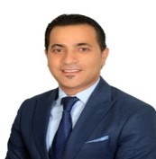
Engagement Manager
Esam is a Senior Manager in Risk Advisory - Cyber & Technology Risk - based in Riyadh with over than 19 years of experience in the field of Business Continuity Management, Risk Management and BCM software implementation.
Prior to joining Deloitte, Esam has held several positions with multiple Consulting and Information Technology firms as a Business Continuity Manager.
Esam has also worked as an Assistant Risk Manager for one of the leading Banks in Jordan where he was supporting Operational Risk ,Business Continuity and Information Security.
Esam Shana’a
Senior Manager
Key Relevant Engagements – Outline
Esam has performed and managed engagements in a wide range of environments, including:
Managed and performed Business Impact Analysis (BIA) exercise that included identifying the urgency of each of the in scope business activities undertaken by the organization by assessing the impact of interrupting those activates over a defined timeframe.
Design/Manage/conduct BCM Awareness and training for Staff.
Development/Review/Update of Business Continuity Plans & Crisis Management Plan (in line with ISO 22301/BS2599 & regulatory guidelines/circulars /regulations).
Executed and managed self assessment exercises that covered Policies, BCPs, BCP testing to ensure alignment with ISO 22301.
Participated in Implementing Disaster Recovery centers, and developing DRPs.
Participated in Implementing Business Alternative sites.
Executed and Managed Implementations of Business continuity Tools.
Conduct BCM Audit against ISO 22301 , SAMA Framework
Managed Risk and Compliance related IT projects.
Professional and Technical Qualification
Bachelors of Science (BSc) in Accounting Sciences from Al Mustansiryah University – Iraq
Certified ISO 22301 Business Continuity Management System Lead Implementer.
Certified ISO 27001 Information Security Management Systems Lead Implementer and Lead Auditor.
Certified by Business Continuity Institute (CBCI)
Member of the Business Continuity Institute (MBCI)
Certified ISO 27001 Information Security Management Systems Lead Implementer and Lead Auditor.
Key Clients Stc Solutions in Saudi Arabia Royal Commission for AlUla Government Agency in Saudi Arabia Leading Commercial and Islamic Banks in ME | Uptown Jeddah Company Thiqah Business Services Leading Insurance Company in Jordan E-Government Program - Yesser Saudi Railway Company – SAR

Slide 41

Subject Matter Expert
Maarten is an experienced consulting leader in a multidisciplinary, international firm with a track record of the successful management of large and complex engagements, live incident, and crisis situations. He is a subject matter expert in crisis management & operational resilience with 20+ years experience. As a Director of the Deloitte Middle East Risk Advisory Practice Maarten is leading our crisis and resilience services in the region.
With a specific focus on our emerging business in KSA and wider region. In times of ongoing geopolitical situations, supply chain challenges, climate change and increasing incidents his mission is to build trust and create space to think. He has extensive experience with IT and technology resilience through supporting clients with disaster recovery planning, third party risk management and cyber incident response. He manages a diverse client portfolio mainly in government & public sector, manufacturing and financial services.
Maarten Smulders
Director
Key Relevant Engagements – Outline
Business Continuity for a global industrial products manufacturer: Lead the design and implementation of a global BCM program. Steer and oversee BCP development in +300 entities worldwide. Support senior and executive management with the response to few major disruptive incidents.
Crisis management assessment for a global consumer brand: Lead a mission to identify and evaluate the global and local crisis management capabilities and overall readiness. Benchmark against peer organizations. Design a roadmap for crisis readiness enhancements. • IT Disaster Recovery for a local life insurer: Lead the design and implementation of Disaster Recovery capabilities for core IT infrastructure, applications and data. Identify business requirements and align DR needs with the technology roadmap. Steer and oversee the DR test program, training of key stakeholders and supplier engagement.
Business Continuity and Cyber Crisis Management for a global consumer brand: Lead the design and implementation of a BCM program for strategic production and logistics facilities. Lead the development of tactical and strategic playbooks for the response to major cyber incidents. Design and facilitate a cyber crisis exercise for senior and executive management.
Business Continuity and Crisis Management for a European Institution: Design, implement and continuously improve departmental business continuity plans and the corporate crisis management plan. Design and facilitate annual simulation exercises, BCP tests, training and awareness. Design and deliver an inter-agency CERT simulation exercise to enhance ransomware response capabilities.
Professional and Technical Qualification
Badmin Facility Management (2006), Netherlands
BCI CBCI (2009)
IRM CIRM (2011)
BS25999 (2008); ITIL (2012)
Key Clients Technology, Media & Telecommunications Government & Public Sector Financial Services Consumer & Industrial Products Energy & Resources

Slide 42

Subject Matter Expert
Syed Waqi Hasan is a Senior Manager at Deloitte’s Cyber Risk Advisory Practice. Waqi holds a Bachelor’s degree in Business Computing from University of Surrey, United Kingdom with more than 18 years of experience in Big Four Advisory, Telecommunications, Banks, Oil & Gas, Manufacturing and Fintech sectors. Waqi has led teams in various projects including IT SOX 404 & ISO 27001 Implementation and Compliance, Cyber & Information Security Risk Management, IT Internal Audits, Business Continuity and IT Risk Management.
Key Relevant Engagements – Outline
Waqi has led several key business continuity engagements in different sectors including Banking, Telecom, Manufacturing, etc. Key experience includes:
Engagement Leader for Business Continuity Management Maturity Assessment at stc head office and its 13 subsidiaries , the largest telco service in the kingdom.
Waqi has served as member of Business Continuity Steering Committee for the Telenor Pakistan and has led Business Continuity and Disaster Recovery initiatives for IT and Technology divisions.
Led the development of Business Continuity Plan and conducted Business Impact Analysis for Faysal Bank.
Waqi served as the member of Steering Committee for the launch of Easy Paisa ensuring that the first Mobile Banking platform in Pakistan is compliant with the Information Security, Disaster Recovery and Business Continuity requirements of Telenor Group and the State Bank of Pakistan.
Waqi worked closely with State Bank of Pakistan to develop Branchless Banking Guidelines and achieved the first ISO27001 certification for Mobile Banking in Pakistan.
Core team member for Business Continuity Enhancement Project (BCEP) at leading LNG company in Qatar assisting the organization in revamping its BCM Program.
Syed Waqi Hasan
Senior Manager
Professional and Technical Qualification
BSc Business Computing
University of Surrey
Diploma Core Leadership-Stockholm School of Economics Oslo, Bangkok, Dubai
Certified ISO/IEC 27001 LA
SAP Certified Consultant (FICO)
Key Clients stc (KSA) Solutions (KSA) Telenor Stc Channels Stc Specialized GSK Pakistan Petroleum Limited Faysal Bank Bank Alfalah | ICI Pakistan Limited Abbot Laboratories Public Procurement Authority Pakistan Stock Exchange

Slide 43

Subject Matter Expert
Sohail is an experienced Senior Manager with Deloitte Risk Advisory, specializing in Business Continuity and Disaster Recovery. He has approx. 10 years of experience in Deloitte where he has been mainly responsible for Business Continuity Management System and Disaster Recovery projects.
Sohail has been part of multiple teams performing end to end business continuity implementations and disaster recovery reviews covering current state assessment; business impact analysis; threat risk assessment; business continuity and disaster recovery strategies; crisis management plans, business continuity plans, IT DR plans; training & awareness; and testing.
Key Relevant Engagements – Outline
During his tenure with Deloitte, Sohail has been engaged in the following projects:
Extensive experience in Business Continuity and Disaster Recovery being part of the team for the following major clients:
2 Public Sector Organizations, 1 Information and Communication Technology organization, 2 theme parks, 1 Motorsports Management Company
All these projects included implementation of Business Continuity Management Systems as per the requirements of international standards such as ISO22301, as well as local UAE Standard issued by NCMEA AE/HSC 7000:2015. The activities included conducting current state assessments of BCMS, Business Impact Analysis for time critical business processes; threat risk assessment; Crisis Management Plan, BC Strategies, BC Plans, and BC Governance Framework; training and awareness; and testing and exercises.
Developed and led the preparation, delivery and closure of multiple simulations. The simulations covered some of the key plans including IT DR Plan, Media Response Plan, Crisis Management and Communication Plan etc.
Sohail Qureshi
Senior Manager
Professional and Technical Qualification
MS in Information and Communication Systems Security – The Royal Institute of Technology (KTH) – Stockholm, Sweden
BS in Electronic Engineering – SSUET Karachi, Pakistan
Certified ISO 22301:2012 Lead Implementer
Certified ISO 27001:2013 Lead Implementer
Certified Information System Auditor (CISA)
Certified Information Security Manager (CISM)
Key Clients NEOM Stc Group Solutions by stc Channels by stc ADNOC, UAE Dubai Electric and Water Authority (DEWA) Majed Al Futtaim Group, UAE The Olayyan Group, UAE

Slide 44
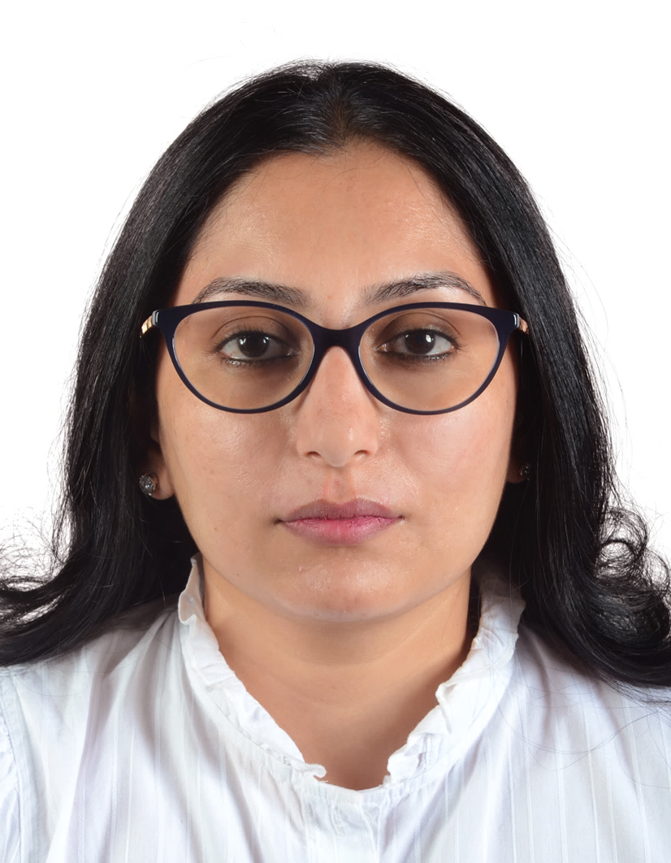
Senior Consultant
Varsha is a Senior Consultant at Deloitte’s Cyber Services practice. She is an IT engineer with an MBA in finance having over 8 years of experience in Banking and IT industry. She is an experienced BCM consultant with certificate of The BCI (CBCI) and ISO 22301:2019 Lead Auditor. She has hands on experience in development and implementation of Business Continuity Management System and development of Disaster Recovery Plan.
Key Relevant Engagements – Outline
Varsha has successfully delivered & implemented Business Continuity Management System including :
Documentation development requirements based on NCEMA 7000:2021 and ISO 22301:2021 requirements.
This includes and is not limited to : Business Impact Analysis procedure, Threat Risk Assessment procedure, Testing and Exercising procedure, Business Continuity Management Governance, Business Continuity Management Manual, Business Continuity Management Policy and Supporting Documents.
Conducted Business Impact Analysis for Federal Authority.
Identified organization’s critical processes, recovery requirements and critical dependencies.
Supported onsite team with required research, analysis, and documentation for conducting Business Impact Analysis (BIA)
Training & capacity building.
Varsha Sastry
Senior Consultant
Professional and Technical Qualification
Bachelor of Engineering – Information Science – Visweswaraya Technological University, India
Master in Business Administration – Institute of Chartered Financial Analysts of India, India
Certified in Business Analytics - Harvard Business School, USA
ISO 22301 Lead Auditor – BSI
Certificate of the BCI (CBCI) with merit
Key Industries served: Financial services Government Real Estate Development

Slide 45
Credentials

Slide 46







Our Credentials
Our BCM and Resilience Experience
Our Middle East BCM practice has experienced practitioners and consultants certified in the business continuity field. We have successfully developed and evolved BCMS, implemented end-to-end projects, assessed readiness and maturity, and advised on BCM best practices.

Slide 47



Our Credentials
Our BCM and Resilience Experience
Royal Commission for Al Ula
Uptown Jeddah Company
ROSHN Real Estate Company
Ministry of Commerce
Project Details
Project Details
Project Details
Project Details
Establishment and operation of Governance, Risk and Compliance (GRC). Due to its vast experience in GRC, its qualified team and strong relationships, Deloitte has recently completed a mega project for the Royal Commission for AlUla (RCU). Deloitte is responsible for the establishment of the GRC function based on the build-operate-transfer model over an 18-month period. The scope of work covered the development of the enterprise risk, enterprise resilience, governance, ethics and compliance departments part of the GRC division.
Uptown Jeddah Company engaged Deloitte & Touche Advisory Saudi Limited to Establish the Business Continuity Management Function and implement an end-to-end Business Continuity Management System for the Company. The project had a timeline of 10 Months.
The scope of work covered the establishment of the function develop the policy and operating model, in addition to BCM Framework and manual procedures. Also as part of the scope performing Threat Risk Assessment and Business Impact Analysis for the whole entity. As a result of this analysis, Deloitte has delivered an updated Business Continuity Plans and Recovery Strategies that are will support Uptown Jeddah Company in recovering their time critical services and operations in a timely manner.
As part of the scope Deloitte developed the Incident Response and Crisis Management framework and related plans.
ROSHN is a real estate entity established under the Public Investment Fund (PIF).
ROSH partnered with Deloitte to implement a robust BCMS in light of ROSHN’s mission and vision to make long term investments in the future of cities across Saudi Arabia by developing great communities with best-in-class homes and to be the most trusted community developer in Saudi Arabia. The engagement was completed over a period of 8 months, with below key outcomes:
A Business Continuity Management System which is aligned with the ISO 22301:2019 standards and is reflective of ROSHN’s culture and operations.
Trained, skilled professionals who understand the importance of resilience, and are confident and competent to complete their assigned roles in the BCMS.
Deloitte & Touche Advisory Saudi Limited led the development and implementation efforts for a comprehensive Business Continuity Management program for MC for a period of 10 Months. The project comprised of establishing BCM Governance Policies and Procedures as well as conducting organization-wide Business Impact Analysis, IT Disaster Recovery Assessment and Threat Risk Assessment outlining the recovery time and recovery point objectives for the MCs critical services and processes. Moreover, a number of exercises (Tabletop and Simulation) have been conducted to evaluate MC’s crisis preparedness.

Slide 48



Our Credentials
Our BCM and Resilience Experience
Saudi Arabian Monetary Authority (SAMA)
Saudi Payments (SADAD)
Bupa Arabia
Tadawul
Project Details
Project Details
Project Details
Project Details
Deloitte was engaged to develop Business Continuity Development Program for SAMA Head Office, all branches and Committees across the Kingdom. In line with the understanding of the vision and requirements of SAMA, Deloitte built on its realization of the scale and criticality of such an important initiative by investing 24 months of extensive efforts of hands-on involvement to develop an end-to-end BCM program. The dedicated team steered the development of the program in its initial stages by assessing and understanding existing resilience capabilities of the organization, only to be followed with a multi-month in-depth BIA of the entire organization (including the Headquarters in Riyadh as well as the authority’s ten branches across the kingdom) to derive the authority’s time-critical processes and identify recovery requirements needed to support the recovery of such processes.
Saudi Payments (ex. SADAD Payment System) was established by the Saudi Arabian Monetary Authority (SAMA) to be the national Electronic Bill Presentment and Payment (EBPP) service provider for the Kingdom of Saudi Arabia (KSA). The core mandate for SADAD is to facilitate and streamline bill payment transactions of end consumers through all channels of the Kingdom’s Banks. SADAD was launched on October 3, 2004. SADAD links the commercial sector and local banks, offering the ability to collect customer payments electronically through all the banking channels in the kingdom 24 hours a day.
Deloitte has been appointed by SAMA to manage the Governance, Risk and Compliance function of SADAD for 2 years. This includes management and maintenance of Business Continuity Management, Enterprise Risk Management, Information Security Governance, Fraud Risk Management and Compliance Management.
Bupa Arabia, a leading insurer in Saudi Arabia, engaged Deloitte to develop and implement an end-to-end BCM Program covering their Head Office and other locations.
Deloitte & Touche M.E is working with Bupa Arabia to deliver an end-to-end BCM Program, focusing on developing a well prepared framework to minimize the impacts due to business disruption, provision to protect the interests of key stakeholders, and establish a process for internal communication, decision making and priority setting during incidents.
Our team is working closely with Bupa to build a culture of resilience to protect its mission, vision, and goals, and to mitigate risks. Deloitte has successfully developed a BCM Framework and Governance structure for Bupa and is currently delivering key assessments and strategies, that will be followed by a comprehensive Incident Response and Crisis Management framework.
Tadawul has Business Continuity (BC) arrangements in place and was striving to ensure its BC program is enhanced and up to date.
To achieve this, Tadawul sought the services of Deloitte to provide expert advice and assistance to enable the Risk Management Division (RMD) undertake an update cycle of Tadawul’s BC program with the aim of raising the quality and maturity to the program further (including initiation of expanding the scope of the program to the Subsidiary), and also focusing on building exercising and testing capability.

Slide 49




Our Credentials
Our BCM and Resilience Experience
Saudi National Bank
SEDCO
Ma’aden
OSN
Project Details
Project Details
Project Details
Project Details
Deloitte’s BCM team assisted SNB for a compressive Disaster Recovery (DR) Assessment and helped them to developed an IT Business Continuity Management Program in line with the SAMA BCM Requirements and ISO 22301 Standard requirements.
Deloitte’s BCM team led the development and implementation efforts for a comprehensive business continuity management system for SEDCO Holding. The project includes the development of main strategies and plans for critical departments within SEDCO Holding.
Deloitte & Touche M.E. has been awarded the contract to implement end-to-end Business Continuity Management System for Ma’aden Corporate and all of its business units and affiliate companies including a review of its emergency response procedures for its mines and sites. MA’ADEN has engaged Deloitte to assist in the development of the enterprise wide Enterprise Risk Management (ERM) Program and the BCM Program concurrently. The Project is expected to last 2 years at the initial onset and to cover the entire units and sites in scope.
Deloitte & Touche M.E. led the development and implementation efforts for a comprehensive Business Continuity Management program for OSN’s operations. We conducted organization-wide business impact analysis outlining the recovery time and recovery point objectives for the organization’s critical business processes. Each technology application supporting the various processes has been identified, along with its corresponding recovery objectives.

Slide 50




Our Credentials
Our BCM and Resilience Experience
Dubai Airports
TECOM Group
Dubai International Financial Center
Aramex
Project Details
Project Details
Project Details
Project Details
Deloitte was engaged to conduct a Technology Resilience Assessment at Dubai Airports, where key activities included:
Performing a complete end-to-end Business Impact Analysis (BIA) for the Business Technology department for the following areas:
Data Centers which are on premise at Dubai Airports (DA) and Dubai World Central (DWC)
IT infrastructure which is on premise at DA and DWC
Network infrastructure
All IT services
Technology touch points within Dubai Airports Operations
Identifying the gaps between the recovery requirements outlined in the BIA against DA’s existing recovery capabilities in order to identify a comprehensive set of additional recovery requirements.
Developing a recommendation report and roadmap to achieve the recovery objectives identified during the BIA report.
Deloitte was engaged to assist in the enhancement of TECOM’s pre-existing Business Continuity Management (BCM) framework. The overall objectives of this engagement aim to focus on the below items:
Review of existing BCM framework documentation and propose enhancements (if required) to existing framework
Review and update existing Business Impact Analysis, associated Business Continuity strategies and plans for significant functions and business processes
Proposal for and execution of appropriately sized BCM tests and future testing schedule
Provide guidance for assisting TECOM with certification
The project was executed over a period of 6 months.
Deloitte was engaged to conduct a refresh of the existing Business Continuity Management (BCM) frameworks within DIFC. The project duration was 6 months, and the scope of work included:
Establishing a revamped BCMS Governance Framework
Conducting BIA and TRA workshops
Identifying recovery strategies and accordingly establishing Business Continuity Plans
Developing a Crisis Management Framework and plan for DIFC management
Conducting BCM training and exercising sessions for selected stakeholders
Deloitte & Touche M.E. led the development and implementation efforts for a comprehensive Business Continuity Management program for Aramex operations. We conducted organization-wide business impact analysis outlining the recovery time and recovery point objectives for the organization’s critical business processes. Each application supporting the various processes has been identified, along with its corresponding recovery objectives. Using the requirements identified, we are developing recovery and resiliency strategies, design documentation, and business continuity plans for each of Aramex’s critical processes.

Slide 51



Our Credentials
Our BCM and Resilience Experience
Dubai Silicon Oasis Authority
Abu Dhabi Police GHQ
Mubadala
Central Bank of Kuwait
Project Details
Project Details
Project Details
Project Details
Deloitte & Touche M.E. was engaged to implement an end-to-end Enterprise Risk Management & Business Continuity Management system for a key governmental entity in Dubai, a municipal body of the free zone. The project aims at achieving compliance with ISO22301 for Business Continuity Management Program.
The project aims to establish the BCM governance framework, perform a Business Impact Analysis and Threat Assessment workshops to prioritize critical processes, develop BC strategy & plan & conduct BCM exercising as part of the implementation support. The total project duration is 12 months covering 20 departments.
Deloitte & Touche M.E. is implementing a BCM program with Abu Dhabi Police (ADP). The project aims at achieving compliance with ISO22301 Business Continuity Management program and National Crisis and NCEMA 7000 standards. We are engaged to:
Perform Current State Assessment
Create BCM Governance Framework
Perform a Business Impact Analysis and Threat Assessment
Business Continuity Strategy Development & Implementation
BCM Training and Exercising
Critical design considerations like alignment with the requirements of NCEMA; integration with Enterprise Risk Management System, Crisis Management System, IT Disaster Recovery Planning & Procedures, Health, Safety & Environment System, ADP’s Quality Management System; and abiding by the Sheikh Khalifa Excellence Award have been incorporated within our approach to ensure successful implementation.
Deloitte & Touche M.E. was requested to perform a Business Impact Analysis for all Business and Support functions of Mubadala (the investment arm of the Government of the State of Abu Dhabi) in order to drive the next steps in the implementation of the Business Continuity and Disaster Recovery initiatives
Deloitte & Touche M.E. led the development and implementation efforts for a comprehensive business continuity management program for the Central Bank of Kuwait. We began our efforts with a bank-wide business impact analysis, resulting in a detailed, requirements report, outlining the recovery time and recovery point objectives for the bank’s critical business processes. Each application supporting the various processes was also identified, along with its corresponding recovery objectives. Using the requirements identified, we developed strategies, designed and documented, business continuity plans for each of the central bank’s critical processes. We documented recovery plan covering the BETH3 asset mix outlined in Deloitte’s recommended BCM methodology.

Slide 52
About Deloitte

Slide 53
About Deloitte
Global Presence
Our shared values guide the way we behave to make a positive, enduring impact.
We contribute to society, building confidence and trust in the market, upholding the integrity of organizations, and supporting our communities.
At the heart of everything we do is a set of Shared Values. These values serve as the basis for the decisions we make and the actions we take, enabling us to deliver impact how and where it matters most for Deloitte clients, our people, and society.
Lead the way
With our unmatched scale, scope, skill, and service excellence, Deloitte is not only leading the profession, but reinventing it for the future. And we are putting those same attributes to work in our communities, creating opportunity and leading the way to a better, stronger, and more sustainable world.
Serve with integrity
By acting ethically and with integrity, and serving as role models in our communities, Deloitte has earned the trust of clients, regulators, and the public. Upholding that trust is our single most important responsibility – the reason we do what is right, always.
Take care of each other
Deloitte’s culture is grounded in the understanding that “we are all in this together.” We look out for one another and prioritize respect, fairness, development, and well-being.
Every day we challenge ourselves to do what matters most— for clients, for our people, and for society.
We inspire our talented professionals to deliver outstanding value to clients, providing an exceptional career experience, and an inclusive and collaborative culture.
Foster inclusion
We are at our best when we foster an inclusive culture and embrace diversity in all forms. We know this attracts top talent, enables innovation, and helps deliver well-rounded client solutions. We are committed to empowering all people to grow and achieve, accelerating diversity in leadership, and building balance for better
Collaborate for measurable impact
We approach our work with a collaborative mindset, teaming across businesses, geographies, and skill sets to deliver tangible, measurable, attributable impact. We measure our success not only by metrics, but by the strength of the relationships we build, the level of innovation we bring to solving problems, and the company we keep as we deliver the best of Deloitte to the world.

Slide 54

About Deloitte
Our Most valuable brand
Connecting for impact for more than 175 years.
Brand Finance has recognized Deloitte as the strongest and most valuable* “commercial services” brand in the world for the fourth consecutive year in 2022 ranking ahead of all major professional services competitors.
A brand isn't just a logo and a color palette. A brand is what people say about you when you leave the room. Their impressions of you. Their experience.
We have a driving purpose and ours is making an Impact that Matters for clients, people and society.
Our resilience is rooted in our ability to respond, adapt and evolve as the world has evolved. Our brand is a symbol of that resilience and the connections we have forged that demonstrate the impact we make.
*Source: Brand Finance Global 500 2022 report

Slide 55
About Deloitte
Deloitte 175
2020 marked 175 years of Deloitte people making an impact that matters.
It is an enduring story that began in 1845 with William Welch Deloitte. An individual with an ideal, integrity and incentive to build something that would last.
He was someone who understood the power of connection as a way to grow. It was the start of a thriving global organization, which has grown to more than 300,000 people proudly carrying forth a legacy of connection and collaboration.
Ideals that remain the bedrock of today’s Deloitte—an organization with the multidimensional perspectives necessary to solve the world’s greatest challenges— in business and society.
It’s in our DNA.

Slide 56
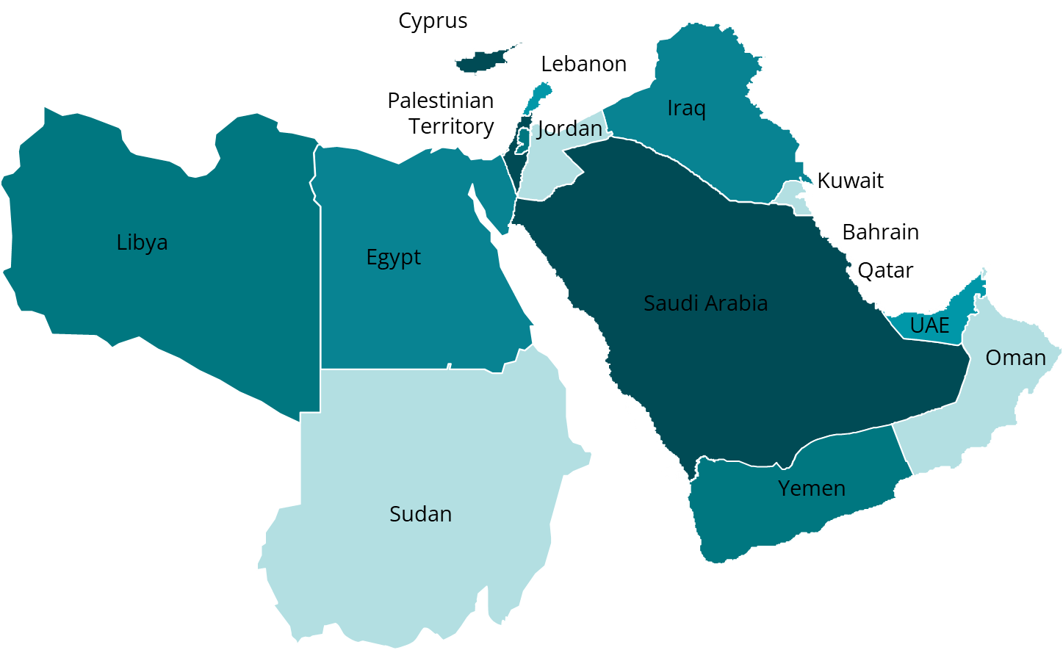

About Deloitte
Deloitte Middle East
We have served as trusted advisors for clients for the past 96 years.
Deloitte clients are able to benefit from experts that are well-aware of the environment, culture, and specific industry that they are operating in.
Deloitte's professionals are dedicated to strengthening corporate responsibility, building public trust, and making a positive impact in their communities.
5,900+
Professionals
39%
Women
105
Nationalities
Deloitte is the world’s largest leading professional services firm, providing audit and assurance, tax, consulting, financial advisory and risk advisory services to public and private clients spanning multiple industries.
Deloitte’s presence in the Middle East has contributed to the advancements and growth of the professional services industry in the region.
15
Countries
29
Offices

Slide 57
About Deloitte
Our Presence in the Middle East
Kingdom of Saudi Arabia
Riyadh Jeddah
Al Khobar
Oman Muscat
Our 5,900 + professionals serve the Levant region and the wider GCC across 15 countries
Palestinian Territories
Ramallah
Iraq
Erbil
Baghdad
Qatar Doha
Jordan Amman
Sudan Khartoum
Bahrain Manama
Egypt Cairo
Kuwait Kuwait City
United Arab Emirates Dubai
Abu Dhabi
Fujairah
Ras Al-Khaimah
Sharjah
Cyprus
Nicosia
Limassol
105
nationalities
Lebanon Beirut
Libya
Tripoli
Yemen
Sanaa

Slide 58
About Deloitte
Our Regional Presence
Deloitte at a glance
Deloitte is established in the Middle East region with uninterrupted presence since 1926 and is present across 29 offices in 15 countries with more than 5,900+ partners, directors and staff.
Internal impact
Deloitte makes an impact that matters to its clients, talent and society. Our practices around the Middle East support clients become leaders wherever they choose to compete. We invest in outstanding people of diverse talents and backgrounds and empower them to achieve more than they could elsewhere. Our work combines advice with action and integrity. We believe that when our clients and society are stronger, so are we.
External impact
Our organization has grown in scale and diversity providing services across the region— with our shared culture remaining the same. We aim to help clients realize their ambitions; make a positive difference in society; and maximize the success of our people. This drive fuels the commitment and humanity that run deep through our every action.
Awards
Deloitte Middle East has received numerous awards in the last few years such as Brand Finance’s strongest and most valuable “commercial services” brand in the world (2022), the Great Place to Work® and Best Workplaces™ in the UAE (2022), Great Place to Work® and Best Workplaces™ in the KSA (2022) and “World’s Most Attractive Employers” (2022)

Slide 59
About Deloitte
Deloitte Middle East is part of NSE
Deloitte North and South Europe (NSE) is the second largest member firm in the Deloitte network.
Deloitte NSE combines our unmatched breadth and depth of capabilities in audit & assurance, consulting, financial advisory, risk advisory, and tax & legal.
As our clients operate in a more globally connected way than ever before, Deloitte NSE helps us provide a seamless cross-border service. Deloitte NSE brings together 3,000 partners and over 100,000 people, providing us with the scale, and the means, to increase our investment in the innovation our clients need.
It is also creating more opportunity and growth for our people, and playing an important part in helping us to embed quality consistently in all we do. Central to our firm is our commitment to our global purpose: to make an impact that matters for our clients, our people and society.
28
countries all part of one firm
Over 100,000
People working across North and South Europe
Read more about how Deloitte NSE makes an impact that matters to clients, people and society.

Slide 60
About Deloitte
Our Purpose Pillars
People
Bringing purpose to life for our people
We believe our people are at their best when they connect their work to a greater cause. We want them to achieve their potential, understand their contribution and feel proud of their impact. And we want a culture that encourages everyone to be themselves.
Our purpose is at the core of our people processes and experiences – from how and who we recruit and the ways in which we evaluate performance, to how we develop our future talent.
We engage with our people to generate fresh ideas for how we can bring our purpose to life. We have also introduced training to embed it across the firm.
Clients
Living our purpose with clients
Our purpose is also central to our work with clients. We aim to:
• Serve with quality and distinction - tackling our clients’ most complex problems, making a measurable and attributable impact, and building trust in the entities we audit and in capital markets.
• Lead the profession - by challenging ourselves to do what matters most, delivering innovative ideas that reflect our capabilities, and driving corporate reform in the public interest
• Contribute to progress in society – acting in the public interest, upholding integrity, and supporting the community.
Society
An impact that matters for society
We want to make a positive impact on society through everything we do, as set out in our Commitment to Responsible Business Practices.
When it comes to our clients, quality and integrity underpin our work and our Global Principles of Business Conduct articulate the high standards we strive to achieve. We are also guided by our Ethics Code.
Through our WorldClass and WorldClimate initiatives, we are focusing our efforts to help address some of today’s most pressing challenges.

Slide 61
Assumptions

Slide 62
Assumptions
General Assumptions (1/3)
CONTRACT TERMS AND CONDITIONS | Deloitte proposal submission is conditional without any liability, upon the parties agreeing mutual favourable terms and conditions within 30 days upon Deloitte being awarded the project.
DELOITTE ENTITY CLAUSE (“DTTL”) | Deloitte Touche Tohmatsu Limited (“DTTL”), is a UK private company limited by guarantee. DTTL and each of the DTTL member firms, their subsidiaries, predecessors, successors, assignees and subcontractors and all partners, associate partners, members, owners, directors, employees and agents of all such entities (hereinafter collectively “D&T Parties”) are separate and independent legal entities, which cannot obligate, bind or act on behalf of each other. Each DTTL member firm renders services in a particular geographic area and jurisdiction and is subject to the laws and professional regulations of the particular country or countries in which it operates. DTTL itself does not render services to clients. DTTL and each DTTL member firm are liable only for their own acts or omissions and not those of each other. This Agreement is solely between the Client and Deloitte & Touche (M.E.) (“Deloitte”).
INTERNAL USE & THIRD-PARTY LIABILITY | Services may include advice and recommendations provided by Deloitte, but all decisions in connection with the implementation of such advice and recommendations shall be the responsibility of, and made by, the Client. Deliverables are supplied on the basis that they are for the sole internal use of the Client and for the exclusive purpose set out therein. Deloitte shall not be liable for any loss, damages, costs or expenses directly or indirectly incurred by any party other than the Client who may rely upon the Deliverables for whatsoever reason. Any advice, recommendation, report, certificate, schedule or other Deliverable arising from or in connection with the Services under this Agreement will be for the sole use of the Client. No person other than the Client shall be entitled to make use of any Deliverable, unless this has been agreed to in writing between the Parties, in advance, and subject to terms agreed between the Parties. Any such advice, recommendation, report, certificate, schedule or other Deliverable is based on the particular facts and circumstances of the Client at a particular point in time. Consequently, such advice, recommendation, report, certificate, schedule or other Deliverable may not be relevant to another Party or at a different time and under different circumstances..
CLIENT RESPONSIBILITY | The Client and related parties, e.g., hardware/software providers or Internet Service Providers, shall cooperate with Deloitte in the performance by Deloitte of the Services, including, without limitation, providing Deloitte with reasonable facilities and timely access to data, information and personnel of the Client. The Client shall be responsible for the performance of its personnel and agents and for the accuracy and completeness of all data and information provided to Deloitte for purposes of the performance by Deloitte of the Services. The Client acknowledges and agrees that Deloitte’s performance is dependent upon the timely and effective satisfaction of the Client’s responsibilities hereunder and timely decisions and approvals of the Client in connection with the Services. Deloitte shall be entitled to rely on all decisions and approvals of the Client. The Client shall be solely responsible for, among other things: making all management decisions and performing all management functions. designating a competent management member to oversee the Services. evaluating the adequacy and results of the Services and accepting responsibility for the results of the Services. establishing and maintaining internal controls, including, without limitation, monitoring ongoing activities; and providing Deloitte with correct and accurate information, data, form or any other required to complete its Services, as Deloitte will carry no liability for any incorrect information provided by the Client.

Slide 63
Assumptions
General Assumptions (2/3)
SUBCONTRACTING / MEMBER FIRMS (if applicable) | Deloitte may, from time to time in its sole discretion, subcontract external companies to provide resources to Deloitte, to enable Deloitte to fulfil its obligations under this engagement. For purposes of this engagement, Personnel of such a subcontractor would be included in the Personnel of Deloitte. In the event of another D&T Party providing resources to Deloitte for the Project, such D&T Party would, for the purposes of this engagement, be considered a subcontractor to Deloitte without a need for the Client prior written consent. Notwithstanding the fact that certain Services under the engagement may be carried out by Personnel provided to Deloitte from other D&T Parties through service or other internal agreements, the Client agrees that none of the D&T Parties (except Deloitte Contracting Party) will have any liability to the Client and that the Client will not bring any claim or proceedings of any nature (whether in contract, delict, breach of statutory duty or otherwise and including, but not limited to, a claim for negligence) in any way in respect of or in connection with this engagement against any of the D&T Parties (except Deloitte contracting party) nor against any subcontractors that Deloitte may use to render the Services.
TRANSFER OF CONFIDENTIAL & PERSONAL INFORMATION | Notwithstanding any other term in the Client Request for Proposal, the Client Group’s management acting on behalf of its shareholders provide their consent ,by issuance of the Request for Proposal, for Deloitte to transfer the Group’s information to other members of the Deloitte Network, third parties or contractors providing administrative, infrastructure and other support services for the needs of our completion and submission of the Request for Proposal, and to store and process any information received, wherever located within or outside of Abu Dhabi and Dubai, in the United Arab Emirate. In this respect, members of the Deloitte Network and third parties are bound by similar confidentiality, privacy and data security obligations (“Confidentiality and Privacy Obligations”) to those contained in this Request for Proposal. In addition, such members of the Deloitte Network and third parties will keep all data confidential and private and will be shared with their employees/ management/ partners/ agents/ officers/ members strictly on a need to know basis (“Authorized Recipient”). The Authorized Recipients are also bound by similar Confidentiality and Privacy Obligations. The Client and Deloitte shall both be solely responsible for its own breach of Confidentiality and Privacy obligations including that of its Authorized Recipient. The above provision constitutes an express written consent from the Group’s management acting on behalf of its shareholders regarding the transfer of the Group’s information to the abovementioned third parties.
INDEPENDENCE | Deloitte is required to maintain, and to be seen to maintain, its independence as auditors when rendering non-audit services to, and forming business relationships with, audit clients. Deloitte is therefore prohibited from rendering certain consulting services or forming business relationships which may result in a Conflict of Interest or a lack of Independence for Deloitte. Please note that Deloitte will not perform any professional services until the results of any internal Client and Engagement Acceptance procedures have been completed, including Conflict and Background Checks and approval from the audit committee. Deloitte reserves the right, without any liability, to withdraw from this opportunity in the event that any conflict of interest or independence issues arise as a result of the Client and Engagement Acceptance procedures.

Slide 64
Assumptions
General Assumptions (3/3)
TERMINATION DUE TO AUDITOR INDEPENENCE | Deloitte may terminate this Agreement or any impacted part of the Services due to Auditor Independence, without incurring any penalty. Deloitte’s right to terminate: Where a governmental, regulatory or professional body, or a relevant authority having the force of law, has introduced a new, or modified an existing, law, rule, regulation, interpretation or decision, the result of which would render the provision of, or any part of the services provided by the Deloitte illegal or otherwise unlawful, or in conflict with independence or professional rules.
COVID-19 | Due to the latest travel restrictions applied to flights and passengers departing from certain destinations, and considering rapid and unexpected changes in the application of these travel restrictions, Deloitte cannot guarantee that any of resources and team members will be available on the ground at the project start date or at any date thereafter. If these risks materialize to any of the Deloitte project team members (and our experts, as applicable) before and/or during project implementation, both Parties will collaborate to redesign the project delivery model while taking advantage of digital methods of team communication and cross-border cooperation to reduce the impact on the project where possible. Deloitte will continue to monitor the situation across the region and will keep an open channel of communication with you in order to deploy the most effective methods of delivery, where possible, and while taking into consideration the challenges we encounter regarding the Epidemics or Pandemics, whilst ensuring that the safety and health of both your and our personnel is our priority.
CLIENT’S RIGHT TO AUDIT | The Client agrees to provide Deloitte with at least 2 weeks’ notice prior to the carrying out of an audit for this engagement. Any request for an audit shall be limited in scope to the people, process and technologies involved in the engagement and with Client data. The payment for any audit will be borne by the Client requesting the audit, and any request for an audit will be limited to a maximum of once per calendar year. The Client agrees that if any audit is to be carried out by a client appointed vendor/ third party or external auditor, that Deloitte will be provided with notice of this appointed vendor to allow Deloitte to carry out its internal compliance and conflict check procedures to approve the appointed vendor or not. Deloitte may not be audited by a competitor.

Slide 65
Assumptions
Technical Assumptions (1/2)
Technical Assumptions | Phase 1: Project Initiation & Planning Deloitte proposed engagement team members are subject to change based on availability at the time of agreeing the contract and will be discussed with the client. Time taken during the contract preparation and signing process is not part of this phase and is considered as a pre-project activity. Salam shall provide templates for project documents (e.g. branding templates, project charter, project plan, status update report, etc.) to Deloitte in order to be utilized throughout the course of the project. In case there is no official format, Deloitte will propose its own templates for Salam’s approval. The proposed timeline may be subjected to change based on the availability and level of corporation of key stakeholders which may trigger a change order. The project timeline estimated for 6 months does not take into consideration / include public holidays throughout the course of the project. Whenever possible a hybrid / remote working approach shall be adopted if delivery activities do not require availability on site. We assume that Salam’s management acknowledges that Salam is responsible for all judgements and decisions in matters related to proper responsibility of management. Phase 2: Business Continuity Gap Analysis Gap analysis will be performed against ISO 22301:2019 and CST requirements. Deloitte will not be responsible for any manpower analysis or cost / budget estimation for the initiatives identified in 3-year roadmap. Deloitte will not be responsible for implementation of any BCM initiatives that are not part of the project scope. Phase 3: Business Continuity Governance Framework Deloitte scope of work does not include the appointment personnel to the BCM roles we recommend. The procedures contained in the BCM Framework will remain as draft until the closure of project as certain aspects of the project approach may change during the fieldwork. Deloitte scope of work excludes developing and/or updating any process list, process definition, enterprise architecture, process specific polices and procedures. Phase 4: Business Impact Analysis Our BIA scope of work is limited to the 12 business functions identified in the clarification responses provided by Salam. BIA reports will be developed for each business function, and one consolidated BIA report. We will utilize the impact rating matrix and risk appetite set by the Risk Management function of Salam. In case its not available, we will propose an Impact Rating Matrix template to be utilized by Salam Management; however, actual metrics/thresholds shall be provided by Salam Management. Phase 5: Business Continuity Risk Assessment The in-scope locations for risk assessment include Salam Commercial building (Muraba / Malaz), Salam Technical building in Maseef district, Salam Khobar Branch, Salam Dammam Branch, Salam Jeddah Branch, Salam Warehouses in Riyadh, Jeddah and Dammam and five (05) data centers. We will develop one consolidated BC risk register covering all risks identified across all in-scope locations. Wherever possible, risk assessment workshops will be conducted remotely unless a physical site visit is required. Deloitte will not be responsible for conducting meetings with risk owners for risk mitigation plans. It is expected that Salam’s ERM function will take up this responsibility. Deloitte will not be responsible for implementing any risk mitigations (other than those which are already part of the project scope).

Slide 66
Assumptions
Technical Assumptions (2/2)
Technical Assumptions | Phase 6: Business Continuity Recovery Strategy and Plans Our scope of work for plans will be limited to the development of one centralized Incident Management Plan, Crisis Management Plan and Crisis Communication Plan, BCPs for time-critical departments and one centralized ITDRP. Our scope of work does not include the development of Operational and / or tactical Incident and / or Emergency Response Plans including, but not limited to, Fire Evacuation, Cyber Incident Response, IT Incident Response.. etc. Our scope of work does not include the appointment of personnel to the roles and responsibilities identified across the plans. Deloitte will not be responsible for any activity related to implementation of recovery strategies and solutions implementation. Our scope is limited to developing the IT DRP against the outcomes of BIA and TRA and the approved recovery strategies and identify areas of improvements. Deloitte will not develop any technical architecture, run-books or configuration documentation for recovery of systems. Deloitte assumes that run books and technical procedures are the responsibility of the IT team and technology vendors. Phase 7: Business Continuity Training & Awareness Deloitte will deliver: BCM Awareness materials (4 awareness emails, two posters, 2 screensaver messages) One (01) BCM awareness session for general staff One (01) training session for BCM Committee (C-suite) covering key governance activities, crisis management and crisis communication aspects, etc. Two (02) training sessions for BCM Champions to train them on all BCMS components and key plans Material for E-Learning module (content only) Deloitte will not be responsible in developing the e-learning module (e.g. SCORM file). Deloitte will provide the content only that may be used by Salam. Phase 8: Business Continuity Testing & Performance Monitoring Deloitte will deliver: Four (04) test plans covering four different scenarios Two (02) tabletop exercises for BCPs and one (01) tabletop for IMP, CMP and CCP. Should Salam opt to choose a crisis simulation, Deloitte will conduct a crisis simulations covering IMP, CMP and CCP. Deloitte will not cover any IT DR failover or any integrated exercise as part of the testing / exercising activities. Phase 9: Business Continuity Internal Audit & Management Review Deloitte will assist Salam’s internal audit department in conducting the BCM Internal Audit. However, to maintain independence and avoid any conflict of interest, final execution of audit activities and issuance of report will be done by the Internal Audit team. Should Salam opt for applying for ISO 22301 certification, Deloitte will not be responsible for supporting Salam during stage-1 or stage-2 audits or responsible for responding to any queries from the certifying body. These activities may be covered as part of the activities of BCM expert who would be seconded.

Slide 67
Assumptions
Secondment Assumptions
Secondment Assumptions | APPOINTMENT OF SECONDEE: The Secondee shall be nominated based on the competency required by Salam. Salam shall be allowed the opportunity to interview the Secondee. Salam, in its sole discretion, shall select the Secondee based on the successful interview, after which Salam shall agree the Job Description with Deloitte for the daily requirements of the Secondee. As the Secondee will be subject to the applicable working rules and regulations that apply to Salam’s employees, Salam agrees to provide copies of all such rules and regulations to the Secondee at the start of the Secondment. The Secondee shall remain an employee of Deloitte and Salam shall not have any responsibility towards the Secondee in its capacity as an Employer. TERMINATION AND REPLACEMENT: If for any reason, apart from short-term illness, the Secondee is unable to complete the Secondment term, or if the Secondee resigns from our employment, we will endeavor to provide a replacement member of staff, who will be subject to your approval and on the same terms as the Contract. References in the Contract to the Secondee shall include any such replacement. DELIVERABLES: Secondment will be utilized for the scope of work mentioned in the RFP. Secondee’s timesheet will be reviewed periodically by Deloitte engagement leader and Salam to ensure expectations are being met. Secondee will be available for 60 hours per month for two years. It is agreed that the Secondee shall not be responsible for any outputs produced such as Deliverables and there shall be no liability for any Delivery by said Deloitte Secondee. Deloitte shall have no responsibility for any Deliverable or quality assurance of Deliverables while the Secondee is working under the direct instruction of Salam. Salam shall be solely responsible for determining that the scope and quality of the Secondee’s work is sufficient and appropriate for Salam ’s needs (including accepting responsibility for the results of that work). The Secondee shall report directly to Salam’s appointed representative and work under Salam ’s direction and supervision. Deloitte will not implement/purchase any IT system / application/ software and hardware licenses. CLIENT RESPONSIBILITIES: Salam agrees to remain solely responsible for managing all aspects of their business, for making all management judgements and decisions, for all management responsibilities and operating all accounting, internal control or management information systems. In connection with this Contract, all Deloitte Secondee(s) hereunder, shall be entitled to unequivocally rely on all decisions and approvals of Salam . Salam in its absolute sole discretion shall be liable and responsible for all decisions. LIMITATION OF LIABILITY: Deloitte will not be supervising the Secondee during the Secondment and cannot be responsible for the Secondee's work. During the Secondment, the Secondee is deemed to be Salam ’s agent and Salam agrees to be solely liable for any loss, liability, damage, cost, charge or expense of whatever nature and howsoever caused and including interest (together "Losses") which relate to or arise out of any act or omission of the Secondee. Deloitte shall not be responsible for any Losses resulting from or connected with the work undertaken by the Secondee. If Deloitte are found liable to Salam, Salam agrees that Deloitte, and its personnel shall not be liable to Salam for any claims, liabilities, or expenses relating to this Secondment (“Claims”) for an aggregate amount in excess of the fees paid by Salam to Deloitte pursuant to this Secondment, except to the extent finally judicially determined to have resulted primarily from the bad faith or intentional misconduct of Deloitte. In no event shall Deloitte or its personnel be liable for consequential, special, indirect, incidental, punitive or exemplary loss, damage, or expense relating to this engagement. Deloitte shall not be liable for any loss, damages, costs or expenses directly or indirectly incurred by any party other than the Client as stated above, who may rely upon the Deliverables for whatsoever reason. Call off orders: For the avoidance of doubt, each Purchase Order shall have its own maximum liability, and the Parties record that this will not be cumulative across all Purchase Orders.] RE-PERFORMANCE: If Salam is, with good reason, dissatisfied with the Secondee's work, Deloitte will identify an alternative individual to re-perform (or revise) the Secondee's work provided that any such dissatisfaction is brought to Deloitte’s attention during the period of the Secondment. In the event that re-performance or revision of the original work achieves Salam ’s satisfaction, then Deloitte shall have no further liability in respect of such work. In the event that this re-performance does not achieve Salam ’s satisfaction, Salam ’s exclusive remedy shall be for Deloitte, upon receipt of written notice, the return of professional fees paid to Deloitte hereunder with respect to the services giving rise to such dissatisfaction.

Slide 68
General Business Terms & Conditions

Slide 69
General Business Terms and Conditions (1 of 18)
Master General Business Terms and Conditions
1 Terms of Reference.
1.1 Deloitte hereby agrees to render Services to the Client, as set out in the General Business Terms and Conditions read together with the Proposal (hereinafter collectively referred to as the “Agreement”). Deloitte accepts the appointment to render the Services to the Client on the terms and conditions set out in this General Business Terms and Conditions. All Services rendered by Deloitte for the Client will be in accordance with the agreed terms of reference for the Project as contained in this Agreement unless both Parties in writing agree upon a revision.
1.1.1 It is specifically recorded that a number of assumptions have been made by the Parties around the rendering of Services, and these are as described in the Proposal.
1.1.2 It is agreed that should any of these assumptions be proven to be incorrect (by either Party), this will be treated as a change of scope to the Agreement, and will be dealt with accordingly by the Parties.
1.2 In the event of Services already being delivered, Client agrees that these terms shall apply to the Engagement retrospectively. In the event that any of the General Business Terms and Conditions in whole or in part are found to be illegal, void or unenforceable, the remainder of the terms shall not be impacted and will remain in force.
2 Interpretation.
2.1 The headings to the clauses in this Agreement are for convenient reference purposes only, shall not be used in the interpretation of this Agreement and shall not limit or extend the language of the clauses to which they refer.
2.2 Unless the context otherwise requires:
2.2.1 The singular shall import and include the plural and vice versa;
2.2.2 Words indicating a gender shall import and include other genders;
2.2.3 Words indicating natural persons shall include juristic persons;
2.3 The Gregorian calendar shall be the basis for any years, quarters, months or dates expressed in this Agreement; and
2.4 References to clauses, parts and sections are, unless otherwise provided, references to clauses, parts and sections of this Agreement.
2.5 Order of Precedence:
2.5.1 Proposal;
2.5.2 Letter of Engagement;
2.5.3 Change Order (if applicable, the Change Order would supersede the Proposal and be followed by the General Business Terms and Conditions).

Slide 70
General Business Terms and Conditions (2 of 18)
3 Services.
Shall mean the Services to be rendered by Deloitte to the Client as described in the Proposal (“Services"). The Services could include the production and delivery of Deliverables (“Deliverables”), as described in the Proposal. It is understood and agreed that Deloitte’s Services may include advice and recommendations, but all decisions in connection with the Services of such advice and recommendations shall be the responsibility of, and made by the Client. In connection with its Services hereunder, Deloitte shall be entitled to unequivocally rely on all decisions and approvals of the Client.
4 Change Order.
4.1 If applicable, any amendments to this agreement, including but not limited to new or additional Services to be rendered by Deloitte to the Client outside of the scope of Services included in this Agreement shall be detailed in a (“Change Order”), signed by both parties. Except as expressly modified in the Change Order, all other terms and conditions of the Proposal and General Business Terms and Conditions remain unchanged.
4.2 Unless stated otherwise in a Change Order, each Change Order, as read together with this Agreement, shall form the sole basis of the agreement between the Parties as to its subject matter. Where there is a conflict between the terms of this Agreement and the terms of a Change Order, the Change Order will take precedence.
5 Acceptance and Testing.
5.1 “Acceptance” or “Accepted” or “Accept” means, in respect of any Service or Deliverable, confirmation in writing by the Client that the agreed Acceptance Testing criteria or agreed alternative acceptance formalities have been satisfied in respect of the Service or Deliverable as commercially agreed between the Parties.
5.2 Unless the Letter of Engagement specifies other arrangements, you agree that each Deliverable will be deemed accepted by you (and our Services, or the relevant part of them, completed) when it is in its final form or when you first make use of the Deliverable, whichever first occurs.
5.3 “Deliverable/Service Defect” means:
5.3.1 A material deviation from the Specifications for a Deliverable or Service agreed to in writing between the Parties; and/or,
5.3.2 Non-compliance of a Deliverable or Service with the standards agreed to in writing between the Parties for such Deliverable or Service; and/or,
5.3.3 An error that materially impacts the Client’s ability to use any specific component of a Deliverable; and/or,
5.3.4 An error that materially reduces the effectiveness of a Service rendered; and/or,
5.3.5 An error in a Deliverable or Service that materially negatively impacts the technical performance of the Client’s systems; and/or,
5.3.6 Non-compliance with the scope of work as agreed for a Deliverable or Service, but excluding errors which are minor or cosmetic in nature.

Slide 71
General Business Terms and Conditions (3 of 18)
5.4 “Specifications” means the technical or descriptive specifications of functional, operational, performance or other characteristics required of a Service or Deliverable, as agreed between the Parties from time to time;
5.4.1 It is specifically recorded that the Parties Intend for each Service and Deliverable to undergo Acceptance Testing relevant to such Service or Deliverable, based on Acceptance Testing criteria agreed (or to be agreed) in writing between the Parties, and based on the Acceptance Testing procedure for the Service or Deliverable agreed (or to be agreed) in writing between the Parties.
5.4.2 Each Deliverable shall be considered Accepted by the Client when the Acceptance Testing procedure agreed in writing between the relevant Parties for such a Deliverable, if any, have been completed for such Deliverable.
5.4.3 Acceptance constitutes an acknowledgment, in writing, that the Agreement’s requirements in respect of the tested Service and/or Deliverable have been satisfied as at the date of Acceptance.
5.4.4 The Acceptance Testing procedures for the Services and Deliverables will be described in the Proposal or in the relevant Change Order.
5.5 Disputes related to Acceptance.
5.5.1 In the event that Deloitte considers a Deliverable or Service ready to be Accepted by the Client, and the Client unreasonably withholds or delays such Acceptance, Deloitte shall be entitled to initiate a Dispute.
5.5.2 Test Procedures:
5.5.2.1 The Parties will conduct the Acceptance Testing, and discharge their respective responsibilities, in the manner specified.
5.5.2.2 The Client may appoint any third party, at its sole expense and risk, to assist them with, or to conduct on behalf of the Client, any Acceptance Testing and quality assurance activities, as specified.
5.5.3 Failure of Acceptance Testing:
Following the completion of the Acceptance Testing, or within the 5 (Five) Business Days of formal submission by Deloitte, if the Client considers a Service and/or Deliverable to have failed an Acceptance Test, or considers the Service or Deliverable to contain a Deliverable and/or Service Defect, the Client must set out the basis of this conclusion in writing to Deloitte with the acceptable reasonable period of remedy.

Slide 72
General Business Terms and Conditions (4 of 18)
6 Deloitte Touche Tohmatsu Limited.
6.1 Deloitte Touche Tohmatsu Limited (“DTTL”), is a UK private company limited by guarantee. DTTL and each of the DTTL member firms, their subsidiaries, predecessors, successors, assignees and subcontractors and all partners, associate partners, members, owners, directors, employees and agents of all such entities (hereinafter collectively “D&T Parties”) are separate and independent legal entities, which cannot obligate, bind or act on behalf of each other. Each DTTL member firm renders services in a particular geographic area and jurisdiction and is subject to the laws and professional regulations of the particular country or countries in which it operates. DTTL itself does not render services to clients. DTTL and each DTTL member firm are liable only for their own acts or omissions and not those of each other. This Agreement is solely between the Client and Deloitte.
6.2 The Client agrees that its relationship with DTTL and the D&T Parties is solely with Deloitte as the cited contracting entity herein, contracting with the Client under this Agreement. Notwithstanding the fact that certain Services under the Agreement may be carried out by Personnel provided to Deloitte from other D&T Parties through service or other internal agreements, the Client agrees that none of the D&T Parties (except Deloitte as referenced in this Agreement) will have any liability to the Client and that the Client will not bring any claim or proceedings of any nature (whether in contract, breach of statutory duty or otherwise and including, but not limited to, a claim for negligence) in any way in respect of or in connection with this Agreement against any of the D&T Parties (except Deloitte) nor against any subcontractors that Deloitte may use to render the Services.
7 Payment of Invoices.
7.1 Invoices: Deloitte’s invoices are due per the terms and conditions set forth in the Proposal.
7.1.1 Properly submitted invoices upon which payment is not received within 30 (Thirty) calendar days of the invoice date shall accrue a late charge of the lesser of (i) 1½% (One and a half percent) per month or (ii) the highest rate allowable by law, in each case compounded monthly to the extent allowable by law.
7.1.2 Without limiting its other rights or remedies, Deloitte shall have the right to suspend or terminate the Services entirely or in part if payment is not received within 30 (Thirty) calendar days of the invoice date.
7.1.3 All amounts payable excludes Value Added Taxes “VAT” and the Client, at its sole expense, shall be responsible for all taxes, such as VAT, sales and use tax, gross receipts tax, withholding tax, and any similar tax, imposed or applicable, at date of this agreement or introduced and made applicable by legislation thereafter, whether in retrospect or not, on the Client or on Deloitte in connection with the Services, other than Deloitte’s corporate income and property taxes.
7.2 “Escalation Date” means the anniversary date of the Effective Date.
7.3 “Annual Percentage Change” means, with reference to the most recent statistics available at the Escalation Date, the headline Consumer Price Index annual inflation rate at the Escalation Date, expressed as a percentage for the month in which the Escalation Date occurs.
7.4 Deloitte may, at its discretion, on each Escalation Date, increase or decrease the rates applicable to this Agreement by the Annual Percentage Change.
7.5 Such rate increases, or decreases are to be communicated by Deloitte to the Client 30 (Thirty) calendar days in advance of them becoming effective, providing all relevant documentary evidence as reasonably required by the Client.

Slide 73
General Business Terms and Conditions (5 of 18)
7.6 Disputed Invoices. Should a dispute arise relating to any Project Fees or Reimbursable Expenses due to Deloitte:
7.6.1 The Client must notify Deloitte of the disputed amount(s) in writing, specifying the affected amount(s), and the alleged reasons for such dispute, within 30 (Thirty) calendar days of receipt of the invoice containing the disputed amount(s), failing which the Client shall be deemed to have accepted the invoice as correct, due and payable;
7.6.2 Any notification, as contemplated in the clause above, shall detail the amount(s) disputed and the reason(s) therefore;
7.6.3 The undisputed portion(s) of the invoice shall be payable on the terms defined above;
7.6.4 The Client shall be entitled to withhold payment of the disputed portion(s) of any amount(s) payable until the dispute is resolved;
7.6.5 If the Client disputes, and withholds, an amount in excess of 50 % (Fifty percent) of the relevant invoice total, Deloitte shall be entitled to suspend the rendering of the Services until the dispute is resolved and any amount payable to Deloitte pursuant to the resolved dispute is paid.
8 Charges.
8.1 All fees and charges for the services and applicable expenses and taxes (“Charges”) are set out in the Proposal (“Fee and Payment Schedule”).
8.2 Project Fees and Expenses:
8.2.1 “Project Fees” charged by Deloitte on the Project can include either or both of the following:
8.2.1.1 “Time and Material Fees”, which are based on the actual time spent by Deloitte Personnel on the Project at the rates which are agreed between the Parties, taking into account the experience and seniority of Personnel, and the complexity of work undertaken unless otherwise agreed; and,
8.2.1.2 “Fixed Price Fees”, which are based on the amounts agreed to in writing by the Parties, regardless of the actual time spent by Deloitte Personnel.
8.3 Unless agreed otherwise between the Parties in writing for the Project, out of pocket expenses incurred directly on a Project by Deloitte and its Personnel (“Reimbursable Expenses”) will be charged to the Client at actual cost.
8.4 Reimbursable Expenses include all reasonable costs necessary for the successful completion of the Project including but not limited to travelling, subsistence, goods and services purchased on the Client's behalf, communications, stationery, administration charges, report and presentation material, secretarial time and computer charges.
9 Termination.
9.1 Unless terminated sooner in accordance with its terms, this engagement shall terminate on the completion of the Services.
9.2 This engagement may be terminated by either Party at any time by giving written notice to the other Party not less than 30 (Thirty) calendar days before the effective date of termination.
9.3 Upon termination of the engagement, the Client will compensate Deloitte for all hours and expenses incurred for Services performed through to the effective date of termination. Deloitte reserves the right to waive any discounts provided to clients due to early termination.

Slide 74
General Business Terms and Conditions (6 of 18)
10 Intellectual Property.
10.1 Own Technology: Each Party has created, acquired or otherwise obtained rights in, and may, in connection with the Project, employ, provide, modify, create, acquire or otherwise obtain rights in various concepts, ideas, methods, methodologies, procedures, processes, know-how, techniques, models, templates, generalized features of the structure, sequence and organization of software, user interfaces and screen designs; general purpose consulting and software tools, utilities and routines; and logic, coherence and methods of operation systems (collectively known as the “Own Technology” of each Party).
10.2 To the extent that either Party utilizes any of its property (including intellectual property and its Own Technology) in connection with the Project, such property shall remain the property of that Party. Except for cases where a license is expressly granted in writing, the other Party shall acquire no right or interest in such property. Any improvements or enhancements to a Party’s Own Technology resulting from a Project will remain the property of that Party.
10.3 Notwithstanding anything in this Agreement, each Party will exclusively own all right, title and interest, including but not limited to all rights under all copyright, patent and other intellectual property laws, in and to its Own Technology.
10.4 In the event of either Party requesting the use of the other Party’s Own Technology, outside the scope of the Project, this would be subject to the Parties agreeing to a written license agreement for such use.
10.5 Client Data:
10.5.1 “Client Data” means information of the Client including information relating to subsidiaries or associated companies of the Client and its business, as well as personal data of its employees and of customers, provided by the Client to Deloitte pursuant to Deloitte rendering the Services.
10.5.2 Ownership in all the Client Data belonging to the Client whether under its control or not shall continue to vest in the Client, and Deloitte shall not obtain any proprietary rights in such data. Any improvements or enhancements to the Client Data resulting from a Project will remain the property of the Client.
10.5.3 The Client Data in the possession of Deloitte, or to which Deloitte may have access during the currency of this Agreement, may not be used by Deloitte for any purposes whatsoever other than as may be specifically required to enable Deloitte to fulfil its obligations in terms of this Agreement.
10.5.4 The Client Data is and shall remain the property of the Client and shall be deemed Confidential Information of the Client in terms of this Agreement.
10.6 Deliverables under this Agreement:
10.6.1 Except as otherwise provided in this Agreement, and upon full and final payment to Deloitte of all amounts owing to Deloitte in terms of this Agreement, all Deliverables shall become the property of the Client.
10.7 Intellectual Property Rights of Third Parties:
10.7.1 Deloitte warrants to the Client that the Deliverables or any part thereof do not infringe the intellectual property rights of any third party.
10.7.2 Deloitte undertakes to defend the Client from and against any claim or action that the use or possession of the Deliverables or any part of them infringes the Intellectual Property Rights of a third party (“IPR Claim”), and shall indemnify the Client against all liabilities, costs, expenses, damages and losses (including any direct, indirect or consequential losses, loss of profit, loss of reputation and all interest, penalties and legal and other reasonable professional costs and expenses) suffered or incurred by the Client arising out of or in connection with that IPR Claim.

Slide 75
General Business Terms and Conditions (7 of 18)
11 Limitation on Warranties.
This is a professional services engagement. Deloitte warrants that it shall perform the Services in good faith and in a professional manner. Deloitte disclaims all other warranties, either express or implied, including, without limitation, warranties of merchantability and fitness for a particular purpose. The client’s exclusive remedy for any breach of this warranty shall be for Deloitte, upon receipt of written notice, to use diligent efforts to cure such breach, or, failing any cure in a reasonable period of time (up to a maximum of 1 (One) ) year, the return of professional fees paid to Deloitte hereunder with respect to the services giving rise to such breach.
12 Limitation on Damages and Indemnification.
12.1 The Client agrees that Deloitte, and its personnel shall not be liable to the Client for any claims, liabilities, or expenses relating to this engagement (“Claims”) for an aggregate amount in excess of the fees paid by the Client to Deloitte pursuant to this engagement, except to the extent finally judicially determined to have resulted primarily from the bad faith or intentional misconduct of Deloitte. In no event shall Deloitte or its personnel be liable for consequential, special, indirect, incidental, punitive or exemplary loss, damage, or expense relating to this engagement.
12.2 The Client shall indemnify and hold harmless Deloitte and its personnel from all claims, liabilities, and expenses relating to this engagement, except to the extent finally judicially determined to have resulted primarily from the bad faith or intentional misconduct of Deloitte.
12.3 The provisions of this Clause and Clause 18 shall apply to the fullest extent of the law, whether in contract, statute, tort (such as negligence), or otherwise. In circumstances where all or any portion of the provisions of this Clause are finally judicially determined to be unavailable, Deloitte’s aggregate liability for any claims, liabilities, or expenses relating to this engagement shall not exceed an amount which is proportional to the relative fault that Deloitte’s conduct bears to all other conduct giving rise to such Claims, liabilities, or expenses and on no account shall exceed Deloitte paid fees.
12.4 Deloitte indemnifies the Client against any claim by a subcontractor to Deloitte, arising from payment obligations between Deloitte and the relevant subcontractor, provided that the Client gives prompt notice to Deloitte of any such claim and Deloitte controls the defence thereof.
12.5 The Client indemnifies Deloitte against any loss, damages, costs or expenses directly or indirectly incurred by Deloitte as a result of inaccurate or incomplete information supplied by, or misrepresentations, fraudulent acts or wilful Default on the part of the Client, the Client’s Personnel, or any third party under the control of the Client.
12.6 Deloitte indemnifies the Client against any loss, damages, costs or expenses directly or indirectly incurred by the Client as a result of misrepresentation, fraudulent acts or wilful default on the part of Deloitte, the Personnel of Deloitte, or any third party under the control of Deloitte. Deloitte shall accept liability to the client, only to the extent of its portion of the Services, as agreed.
12.7 The Client indemnifies Deloitte and D&T Parties against any Claim by any third party arising from a copy of any report, certificate, schedule or other Deliverable which the third party received from the Client, its Personnel, or its advisors.
12.8 In the event of the Client not being the final consumer of the Services under this Agreement (the “Consumer”), the client indemnifies Deloitte and D&T Parties against any Claims by the Consumer.

Slide 76
General Business Terms and Conditions (8 of 18)
13 Client Responsibilities.
13.1 The Client and related parties, e.g., hardware/software providers or Internet Service Providers, shall cooperate with Deloitte in the performance by Deloitte of the Services, including, without limitation, providing Deloitte with reasonable facilities and timely access to data, information and personnel of the Client. The Client shall be responsible for the performance of its personnel and agents and for the accuracy and completeness of all data and information provided to Deloitte for purposes of the performance by Deloitte of the Services. The Client acknowledges and agrees that Deloitte’s performance is dependent upon the timely and effective satisfaction of the Client’s responsibilities hereunder and timely decisions and approvals of the Client in connection with the Services. Deloitte shall be entitled to rely on all decisions and approvals of the Client.
13.2 The Client shall be solely responsible for, among other things:
13.2.1 making all management decisions and performing all management functions;
13.2.2 designating a competent management member to oversee the Services;
13.2.3 evaluating the adequacy and results of the Services;
13.2.4 accepting responsibility for the results of the Services;
13.2.5 establishing and maintaining internal controls, including, without limitation, monitoring ongoing activities; and,
13.2.6 providing Deloitte with correct and accurate information, data, form or any other required to complete its Services, as Deloitte will carry no liability for any incorrect information provided by the Client.
14 Non-Solicitation.
The Client, its subsidiaries, parent company or any other of its affiliates undertake that, for the duration of the engagement and for 1 (One) year thereafter, it shall not solicit for employment, nor offer employment directly or indirectly, nor enter into any contract for services, nor engage the services of any team member assigned to this Project by Deloitte. In the event the Client breaches this provision, it shall be liable to the aggrieved party for an amount equal to 30% (Thirty percent) of the higher of either the annual base compensation of the relevant personnel in his/her new position or the annual base compensation of the relevant personnel in his/her last position with Deloitte. Although such payment shall be the Deloitte’s exclusive means of monetary recovery from the Client for any breach of this provision, Deloitte shall be entitled to seek injunctive or other equitable relief, as may be applicable.

Slide 77
General Business Terms and Conditions (9 of 18)
15 Force Majeure.
15.1 Except for the payment of money, neither Party shall be liable for any delays or non-performance resulting from circumstances or causes beyond its reasonable control, including, without limitation, acts or omissions or the failure to cooperate by the Client (including, without limitation, entities or individuals under its control, or any of their respective officers, directors, employees, other personnel and agents), acts or omissions or the failure to cooperate by any third party, fire or other casualty, act of God, strike or labor dispute, war or other violence, or any law, order or requirement of any governmental agency or authority.
15.2 Both Parties agree to reasonably mitigate costs associated with such events, where possible. If the anticipated or actual delay or non-performance exceeds thirty (30) calendar days, the other Party may immediately terminate the Agreement by giving notice of termination. The Client agrees to pay Deloitte for all amounts owed in terms of this Agreement for Services rendered by Deloitte up until the Force Majeure event.
15.3 Additional restrictions and conditions imposed due to epidemics and/or pandemics:
15.3.1 The Parties acknowledge the threat posed by the spread of diseases classified by the World Health Organization as epidemics (“Epidemics”) or pandemics (“Pandemics”), including but not limited to Covid-19 (“Coronavirus”) and the associated impact this might have on the delivery of the Services. The Parties personnel will comply with any restrictions or conditions imposed by their respective organizations on working practices as the threat of Epidemics or Pandemics continues.
15.3.2 Whilst the Parties will seek to continue to comply with their respective obligations in accordance with the timeframes and approach set out in the Letter of Engagement, the Parties accept that they may be required to adopt alternative working practices and put in place safeguards during this period, including but not limited to working remotely, restrictions on travel to and from particular locations and the quarantining of individuals. These working practices and safeguards may impact or prevent the delivery of various activities or deliverables, for example, workshops or other face to face meetings.
15.3.3 Without prejudice to this clause 15 (Force Majeure), the Parties will work collaboratively and in good faith to agree a Change Order to mitigate the adverse impact resulting from the effects of Epidemics or Pandemics on the Services, including the timetable for delivery of the Services, the approach, methods and working practices for delivering the Services, and any additional associated costs.
15.3.4 In any event, Deloitte shall have no liability for any failure or delay to perform its obligations under this Proposal, to the extent caused and/or contributed to by the spread of Epidemics or Pandemics and its associated impact.
16 Limitation on Actions.
No action, regardless of form, relating to this Engagement, may be brought by either Party more than 1 (One) year after the cause of action has accrued, except that an action for non-payment may be brought by a Party not later than 1 (One) year following the date of the last payment due to such Party bringing such action.
17 Independent Contractor.
It is understood and agreed that each of the Parties hereto is an independent contractor and that neither Party is, nor shall be considered to be, the other’s agent, distributor, partner, fiduciary, joint venturer, co-owner or representative. Neither Party shall act or represent itself, directly or by implication, in any such capacity in respect of the other or in any manner assume or create any obligation on behalf of, or in the name of, the other.

Slide 78
General Business Terms and Conditions (10 of 18)
18 Confidentiality and Internal Use.
18.1 The Client agrees that all Services and Deliverables shall be solely for the Client’s informational purposes and internal use, and are not intended to be, and should not be, used by any person or entity other than the Client except as otherwise specifically agreed in writing. The Client further agrees that such Services or Deliverables shall not be circulated, quoted, disclosed, or distributed to, nor shall reference to such Services or Deliverables be made to, any person or entity other than the Client, except as may be required by law or Agreed by the Parties.
18.2 To the extent that, in connection with this engagement, either Party (each, the “Receiving Party”) comes into possession of any trade secrets or other proprietary or confidential information of the other (the “Disclosing Party”), it will not disclose such information to any third party without the Disclosing Party’s consent, except:
18.2.1 to subcontractors that are providing services in connection with this engagement and that have agreed to be bound by confidentiality obligations similar to those in this Clause;
18.2.2 as may be required by law, regulation, judicial or administrative process, or in accordance with applicable professional standards or rules, or in connection with litigation pertaining hereto; or,
18.2.3 to the extent such information:
18.2.3 (a) shall have otherwise become publicly available (including, without limitation, any information filed with any governmental agency and available to the public) other than as the result of a disclosure in breach hereof,
18.2.3 (b) becomes available to the Receiving Party on a nonconfidential basis from a source other than the Disclosing Party that the Receiving Party believes is not prohibited from disclosing such information to the Receiving Party by obligation to the Disclosing Party,
18.2.3 (c) is known by the Receiving Party prior to its receipt from the Disclosing Party without any obligation of confidentiality with respect thereto, or
18.2.3 (d) is developed by the Receiving Party independently of any disclosures made by the Disclosing Party to the Receiving Party of such information. In addition, the Client acknowledges and agrees that any such information that comes to the attention of Deloitte in the course of performing this engagement may be considered and used by Deloitte in the context of responding to its professional obligations as the independent accountants for the Client.
18.3 Deloitte reports will be for the sole internal use of the Client. Provision of the reports to third parties requires Deloitte’s prior written approval. Third party recipients of the reports will be required to enter into separate arrangements with Deloitte, specifying their intended use of the report(s), or indemnify Deloitte by providing “hold harmless” letters. Deloitte will not unreasonably withhold consent for further distribution of the reports, provided that these terms are adhered to.
18.4 Further, the Client agrees that Deloitte may use the Client’s name as a reference, to be included in proposals to other clients and marketing materials developed by Deloitte unless otherwise indicated in writing by the Client.
18.5 The Client agrees not to reference Deloitte’s name or Deloitte’s reports, analysis or other documents prepared by Deloitte in whole or in part, in any document distributed to third parties other than the intended users without Deloitte’s written consent.
18.6 Neither Deloitte’s name nor the material submitted may be included in any prospectus, newspaper publicity or as a part of any printed material, or used in offerings or representations in connection with the sale of securities or participation interest to the public.

Slide 79
General Business Terms and Conditions (11 of 18)
18.7 In the course of providing the Services, we may make reference to spreadsheets and computer models that Client may provide to Deloitte or ask Deloitte to rely upon (“Client Models”) or that we may have developed or used in connection with the Services (“Deloitte Models”). All models have limits and may not produce valid results for all possible combinations of input data. As such, errors and potential errors may go unnoticed. Unless otherwise expressly agreed in the Proposal:
18.7.1 Deloitte will not be responsible for reviewing, testing or detecting any errors in any of the Client Models; and
18.7.2 Deloitte will not provide Client with a copy of Deloitte Models for Client use.
18.8 Deloitte owes no duty of performance to any party other than the Client.
19 Privacy and Data Protection.
19.1 The Client acknowledges that Personal Data may be processed by Deloitte, either in its capacity as a Controller or as a Processor (as applicable), for the purpose of, or in connection with:
19.1.1 The provision of the Services;
19.1.2 Applicable legal or regulatory requirements;
19.1.3 Requests and communications with competent authorities;
19.1.4 Internal and external audits, and/or
19.1.5 Administrative, financial, accounting, risk analysis, and client relationship purposes (the “Purposes”).
19.2 “Personal Data” means any information relating to an identified or identifiable natural person (“data subject”); an identifiable person is one who can be identified, directly or indirectly, in particular by reference to an identifier such as a name, an identification number, location data, an online identifier or to one or more factors specific to the physical, physiological, genetic, mental, economic, cultural or social identity of that natural person.
19.3 “Data Protection Legislation” means any applicable data protection legislation as amended, replaced or superseded from time to time.
19.4 “Deloitte Personal Data” means any Personal Data of Deloitte employees and or/clients processed by the Client on behalf of Deloitte pursuant to or in connection with the Proposal.
19.5 “Controller” means a legal person which, alone or jointly with others, determines the purposes and means of the processing of Personal Data.
19.6 “Processor” means a natural or legal person which processes Personal Data on behalf of the Controller.
19.6.1 The Client acknowledges that without the provision of the requested Personal Data, Deloitte may not be able to provide the Services to the Client or carry out any of the other Purposes referenced herein. In providing the Services to the Client or otherwise in connection with the Services, Deloitte may also occasionally contact the Client with details of events/seminars Deloitte is holding, Deloitte may send you publications or newsletters which we believe are of interest to the Client, or provide the Client with direct marketing or promotional communication for subjects which may be of interest to the Client.

Slide 80
General Business Terms and Conditions (12 of 18)
19.6.2 Personal Data may be disclosed to, and processed by, other members of the Deloitte Network, Deloitte’s service providers and competent authorities for one or more of the Purposes. The processing and disclosure of Personal Data may involve the transfer of Personal Data to other jurisdictions cross border only insofar as such a transfer is necessary for the performance of the Agreement. In such cases, Deloitte shall take adequate measures to ensure that such transfer is in compliance with applicable Data Protection Legislation or according to Deloitte’s Privacy Policies and Procedures and that direct recipients shall provide the same level of protection. Deloitte has in place appropriate technical and organizational measures to ensure that the Personal Data are secure, having regard to the level of the risk, the state of technological development and the costs of implementation. Deloitte shall ensure that all persons authorized to process the Personal Data for the Purposes (including, without limitation, Deloitte’s employees, agents or contractors) are obliged to keep the Personal Data confidential.
19.6.3 Where Deloitte acts as a Processor, it shall additionally:
19.6.3 (a) Process Personal Data on the lawful written instructions of the Client;
19.6.3 (b) Provide reasonable assistance to the Client, at the Client’s cost, in responding to any data subject request in relation to the data subjects’ rights and in ensuring compliance with its obligations under the applicable Data Protection Legislation and Deloitte’s Privacy Policies and Procedures in relation to security, breach notifications, impact assessments and consultations with supervisory authorities;
19.6.3 (c) Notify the Client without undue delay on becoming aware of a personal data breach where the Personal Data have been, or are likely to have been, compromised;
19.6.3 (d) At the written direction of the Client, delete or return Personal Data and copies thereof on termination of the Agreement, subject to the provisions of any legal and/or regulatory requirements with which Deloitte must comply;
19.6.3 (e) Make available to the Client, upon the Client’s request, all information necessary to demonstrate compliance with this Clause; and
19.6.3 (f) Engage other sub-processors only with the prior notification of the Client and provided Deloitte will enter into a written agreement with such sub-processors, incorporating terms, which are substantially similar to this Clause.
19.6.4 Where Deloitte acts as a Processor, the Client agrees that it shall communicate to Deloitte any rectification or erasure of any Personal Data which Deloitte holds or restriction of processing of such Personal Data to Deloitte unless, in Client’s reasonable opinion, such communication proves impossible or involves disproportionate effort.
19.6.5. The parties acknowledge and agree that this Data Protection Clause forms a summary of the applicable Deloitte privacy policy (the “Privacy Policy”).
19.6.6. Deloitte may retain any Personal Data provided by the Client in connection with the Purposes in accordance with Deloitte’s data retention policy which may be found in the Privacy Statement and which is in compliance with applicable Data Protection Legislation.
19.6.7. The Client shall ensure that it has all necessary consents and notices in place to enable the lawful transfer of the Personal Data to Deloitte for the duration and Purposes of this Agreement. Both parties will comply with all requirements of the applicable Data Protection Legislation and Deloitte’s Privacy Policies and Procedures when processing Personal Data. The Client shall ensure that it does not knowingly or negligently do or omit to do anything which places Deloitte in breach of its obligations under the Data Protection Legislation. The Client shall indemnify Deloitte against all costs, expenses (including legal expenses), damages, loss (including loss of business or loss of profits), liabilities, demands, claims, actions or proceedings, which Deloitte may incur arising out of any breach by the Client of its obligations under these Data Protection Legislation clauses.

Slide 81
General Business Terms and Conditions (13 of 18)
19.6.8. The following two clauses are applicable when Deloitte acts as a Controller and provides services to Individuals ONLY. These clauses will not be applicable in case Deloitte acts as a Controller and provides services to legal entities or in case Deloitte acts as a Processor:
19.6.8 (a) The Client has the right to request from Deloitte at any time access to, rectification or erasure of his/her Personal Data or restriction of processing of his/her Personal Data concerning him/her or to object to processing as well as the right to data portability. The Client can find further details in relation to his rights and the extent to which he can exercise them in Deloitte’s Privacy Policy.
19.6.8 (b) If the Client has a complaint or query with regards to the way his/her Personal Data are handled by Deloitte, the Client can contact the Privacy Office at DMEprivacy@deloitte.com. If the Client is not satisfied with the way Deloitte has handled a complaint regarding his/her Personal Data, the client has the right to lodge a complaint with the Data Protection Authority, where applicable.
19.7 Transfer of Confidential and Personal Information:
Notwithstanding any other term in this Agreement, the Client Group’s management acting on behalf of its shareholders provide their consent by signing this Agreement that, Deloitte may transfer the Group’s information to other members of the Deloitte Network, third parties or contractors providing administrative, infrastructure and other support services such as audit review support and subcontractors providing services as part of the engagement to store and process any information received, wherever located within or outside of the Kingdom of Saudi Arabia. In this respect, third parties are bound by similar Confidentiality, Privacy and Data Security Obligations (“Confidentiality and Privacy Obligations”) to those contained in this Agreement. In addition, such third parties will keep all data confidential and private and will be shared with their employees/ management/ partners/ agents/ officers/ members strictly on a need to know basis (“Authorized Recipient”). The Authorized Recipients are also bound by similar Confidentiality and Privacy Obligations. Each party shall be solely responsible for its own breach of Confidentiality and Privacy obligations including that of its Authorized Recipient. The above provision is as an express written consent from the Client Group’s management acting on behalf of its shareholders regarding the transfer of the Client Group’s information to the abovementioned third parties.

Slide 82
General Business Terms and Conditions (14 of 18)
20 Electronic Communications.
20.1 The Parties agree that we may communicate with each other by way of business e-mail (including the internet). The Client acknowledges that, in order for Deloitte personnel to operate effectively and efficiently from the Client’s premises, Deloitte personnel may require access to the Client’s networks, for example, to enable access to Deloitte applications and systems. If Deloitte personnel need to have access to the Client’s systems in order to perform the Services, the Parties acknowledge that such access may be subject to further terms and conditions that are intended to protect the security and integrity of the Client’s data and systems, provided that the Client informs Deloitte of any such terms and conditions before such access takes place.
20.2 The Parties recognise that e-mail and the internet are inherently insecure and that e-mails and data can become corrupted, communications are not always delivered promptly (or at all) and that other methods of communication may be appropriate. In addition, the internet is prone to malware. Similar hazards apply where Deloitte access its systems via Client networks. The Parties recognise these hazards and therefore each Party will be responsible for protecting their our own systems and interests and neither Deloitte nor the Client will be responsible to the other on any basis (contract, tort or otherwise) for any loss, damage or omission in anyway arising from the use of e-mail (including the internet) as a form of communication or from Deloitte personnel connecting to or accessing your network. The exclusion of liability in this clause shall not apply to any liability which arises out of the negligent incorrect addressing of any electronic communication.
20.3 Deloitte will not initiate communications with the Client via instant messaging channels (such as WhatsApp, WeChat or other social media platforms or personal email addresses (such as Gmail, yahoo mail, Hotmail, etc.) as Deloitte does not have control over these and such use may prejudice the confidentiality of the Client’s information. If the Client communicates with Deloitte via instant messaging or personal email addresses, Deloitte will not be held liable for any data breach which results from transmitting information through these means, nor will Deloitte be liable for any direct or indirect loss resulting from a data breach caused by using instant messaging, personal email addresses or by third parties intercepting Client information.
20.4 Cloud Technology:
Deloitte is committed to implementing new and innovative technologies, advanced analytics and cloud-based solutions (“Cloud Technology”) to better serve our clients through more collaborative ways of working. By signing this Agreement, as the Client management, acting on behalf of its shareholders, you provide us with your consent that Deloitte may transfer, process (including collecting, recording, ordering, accumulating, storing, updating or modifying, extracting, utilizing, redacting, blocking, removing, erasing and transferring) or host your information using such Cloud Technology. In addition, you consent that Deloitte may use such Cloud Technology, which may be located outside of the Country, for the purpose of delivering the Services in this Agreement, on the understanding that Deloitte and any of the Deloitte Parties, or other subcontractors used in delivery of the Services, shall keep your information confidential in line with the provisions of this Agreement and, in the case of Personal Data, in accordance with the requirements and obligations of any applicable data protection law. The above provision refers to an explicit consent from you regarding the transfer, processing or hosting of your information in such Cloud Technology. In addition, you agree that Deloitte shall not be held liable for the transfer, processing or hosting of your information to and by the above-mentioned parties, or for the use of Cloud Technology for this purpose. You confirm that the information is suitable for transfer and is not restricted as per relevant applicable law.

Slide 83
General Business Terms and Conditions (15 of 18)
21 Survival and Interpretation.
The terms of any Clauses which by its nature should survive to give adequate meaning and effect to the provisions of this Agreement and/or Change Order will survive the termination or expiration of the entire or any part of this Agreement and/or Change Order.
22 Assignment and Subcontracting.
22.1 Assignment.
Except as provided below, neither Party may assign, transfer or delegate any of its rights or obligations hereunder (including, without limitation, interests or claims relating to this engagement) without the prior written consent of the other Party. Deloitte may, with written notice, but without the consent of the Client, assign or subcontract its rights and obligations hereunder to (a) any affiliate or related entity or (b) any entity that acquires all or a substantial part of the assets or business of Deloitte.
22.2 Subcontracting.
Deloitte shall have the right to subcontract its obligations under this Agreement, provided that Deloitte shall remain responsible to the Client for the fulfilment of obligations assumed in terms of this Agreement, under the following circumstances:
22.2.1 Subcontracting components of the Services:
22.2.1 (a) Deloitte may not subcontract any or all of the Services to be rendered under the Agreement on its behalf, without the prior written approval of the Client, which approval shall not be unreasonably withheld or delayed. Subcontractors listed in the Agreement, or in a Change Order, will be deemed approved.
22.2.1 (b) Deloitte is responsible for ensuring that any obligations which it subcontracts are fulfilled by any such subcontractor(s) concerned.
22.2.2 Subcontracting for Resources:
22.2.2 (a) Deloitte may, from time to time in its sole discretion, subcontract external companies to provide resources to Deloitte, to enable Deloitte to fulfil its obligations under this Agreement. For purposes of this Agreement, Personnel of such a subcontractor would be included in the Personnel of Deloitte.
22.2.2 (b) In the event of another D&T Party providing resources to Deloitte for the Project, such D&T Party would, for the purposes of this Agreement, be considered a subcontractor to Deloitte.
22.2.2 (c) Deloitte shall not be required to disclose the existence or terms of any other subcontract entered into in such instances, but shall take the Client’s reasonable wishes into account in its choice of such subcontractors.

Slide 84
General Business Terms and Conditions (16 of 18)
23 Dispute Settlement.
In the event of a dispute, Deloitte and the Client agree to work with the other Party to resolve the disputed matters in good faith, including providing the other with written notification of the disputed matters and affording the other reasonable time, not exceeding 1 (one) month (30 days) or a mutually agreed upon time frame, to implement corrective measures to the satisfaction of the Disputing Party and obtain written acknowledgement of the same. Only after exhausting all possible options of dispute resolution may either Party consider legal recourse as the option of last resort in accordance with the Kingdom of Saudi Arabia rules.
24 Governing Law and Severability.
These terms, the Proposal to which these terms are attached, including exhibits, and all matters relating to this engagement whether in contract, statute, tort (such as negligence), or otherwise, shall be governed by, and construed in accordance with, the laws of the Kingdom of Saudi Arabia. If any provision of such terms or Proposal is found by a court of competent jurisdiction in the Kingdom of Saudi Arabia, to be unenforceable, such provision shall not affect the other provisions, but such unenforceable provision shall be deemed modified to the extent necessary to render it enforceable, preserving to the fullest extent permissible the intent of the Parties set forth herein.
25 Disclaimer.
25.1 It is understood and agreed that the Services may include advice and recommendations provided by Deloitte, but all decisions in connection with the implementation of such advice and recommendations shall be the responsibility of, and made by, the Client.
25.2 Deliverables are supplied on the basis that they are for the sole internal use of the Client and for the exclusive purpose set out therein. Deloitte shall not be liable for any loss, damages, costs or expenses directly or indirectly incurred by any party other than the Client as stated above, who may rely upon the Deliverables for whatsoever reason.
25.3 Any advice, recommendation, report, certificate, schedule or other Deliverable arising from or in connection with the Services under this Agreement will be for the sole use of the Client. No person other than the Client shall be entitled to make use of any Deliverable, unless this has been agreed to in writing between the Parties, in advance, and subject to terms agreed between the Parties.
25.4 Any such advice, recommendation, report, certificate, schedule or other Deliverable is based on the particular facts and circumstances of the Client at a particular point in time. Consequently, such advice, recommendation, report, certificate, schedule or other Deliverable may not be relevant to another Party or at a different time and under different circumstances.

Slide 85
General Business Terms and Conditions (17 of 18)
26 Special Terms.
26.1 Deloitte Auditor Independence.
26.1.1 Deloitte is committed to fully complying with the Code of Professional Conduct for Registered Auditors, and the Code of Ethics for Professional Accountants of IFAC (International Federation of Accountants), and the legal requirements of stock exchanges around the world, all as amended from time to time, which require a multidisciplinary firm like Deloitte to maintain, and to be seen to maintain, its independence as auditors when rendering non-audit services to, and forming business relationships with, audit clients.
26.1.2 In the context of the codes referenced above, Deloitte is at times precluded from rendering certain consulting services to, or forming business relationships with, companies that are subsidiaries of, or affiliates of, any company that is listed (or intends listing) on the New York Stock Exchange or the London Stock Exchange, or any other national stock exchange, or which has a subsidiary or affiliate that is listed in the United States or the United Kingdom or elsewhere, for which any D&T Party is an appointed external auditor. The restrictions described in this clause also apply to Deloitte forming business relationships with the management of any such companies in their personal capacities.
26.1.3 Deloitte is also restricted from rendering certain consulting services to, or forming business relationships with, other audit clients of any of the D&T Parties, or their subsidiaries or affiliates, which do not fall into the categories listed in clause 26.1.2 above, including listed and unlisted audit clients unless such services are permissible.
26.1.4 Deloitte and the Client agree to take all reasonable actions to resolve any constraints resulting from this clause 26 without delay. Should it not be possible to resolve any such constraints, Deloitte reserves the right to terminate the Agreement in terms of clause 9 of this Agreement.
26.2 Termination due to Auditor Independence.
Deloitte may, without incurring any penalty, terminate this Agreement in whole or in part, with immediate effect upon written notice to the Client if Deloitte determines that (i) a governmental, regulatory, or professional entity or other entity having the force of law has introduced a new, or modified an existing law, rule, regulation, interpretation, or decision, the result of which would render Deloitte’s performance of any part of this Agreement illegal or otherwise unlawful or in conflict with independence or professional rules or (ii) circumstances change (including, without limitation, changes in ownership of the Client or of its Affiliates, so that Deloitte’s performance of any part of this Agreement would be illegal or otherwise unlawful or in conflict with independence or professional rules.
27 Non-Exclusivity.
The Client acknowledges that the D&T Parties render audit, accounting, financial services, management consulting, consultants, and a variety of other services to a large and diverse range of clients. The rendering of the Services to the Client will not prevent Deloitte or D&T Parties from rendering the same or similar Services to other parties, some of whom could be competitors of the Client or who may be in conflict with the Client. In addition, the existence of this Agreement will not prevent Deloitte or D&T Parties from establishing similar agreements with other parties.

Slide 86
General Business Terms and Conditions (18 of 18)
28 Entire Agreement, Validity and Duration.
28.1 The Agreement, together with all Change Orders, constitutes the entire agreement between Deloitte and the Client as to their respective subject matters, and supersedes all other oral and written representations, understandings or agreements between them as to their respective subject matters. Where there is a conflict between the terms contained in this Agreement and any prior written proposals, quotations or submissions provided by Deloitte to the Client regarding the Services under this Agreement, this Agreement (or the Change Order) will take preference.
28.2 Should either Party wish to make any change to the body of this Agreement, including a Change Order, such change shall only take effect once made in writing and signed by both Parties. The same restriction applies to the waiving of this requirement, which cannot be overridden verbally or by action implying intention.
28.3 This Agreement shall be regarded as commencing on the Effective Date and shall, unless terminated earlier in terms of this Agreement, automatically terminate once the Services under this Agreement have been rendered by Deloitte and all monies related thereto have been paid over by the Client to Deloitte, unless a further agreement, replacing and superseding this Agreement, is established in writing between the Parties.
28.4 All obligations created in this Agreement shall survive change or termination of the business relationship between the Parties, unless such obligations have been expressly terminated in writing by both Parties.
29 Anti-Corruption.
29.1 Each contracting party hereby acknowledges and confirms that each has adopted a policy of zero tolerance to bribery and corruption, implementing a total ban of any corrupt practices and on any facilitation payments. Both parties, in connection to the performance of services, conform and shall continue to abide by the applicable legislation as currently exists or as may be amended from time to time; as well as the internal policies and procedures of each party developed and focused on combating bribery and corruption.
29.2 In connection with its performance of services, each contracting party ensures that the parties and their employees shall be prohibited to offer make, consent to offer or make, any suspicious payment (in cash or valuable gifts) to any persons (including, but not limited to, private individuals, commercial entities and government public officials), and shall not solicit, accept or agree to accept from any person any corruption-related payments (cash or valuable gifts), whether directly or indirectly.
30 Respect and Inclusion Behaviors.
30.1 In relation to the engagement, we each agree to foster a culture and working environment where our people treat each other with respect, courtesy and fairness (“Respect & Inclusion Behaviors”). We are committed to encouraging and enabling conversations to address any behaviors that are not aligned with the Respect & Inclusion Behaviors. If an individual would like to raise a concern, they should discuss the matter within their respective organizations in the first instance, following which a conversation between the Deloitte partner and the Client sponsor will be held to address the matter.
30.2 The parties will communicate the steps taken to resolve the matter and will notify each other of the agreed outcomes in writing.

